Slide 1
1st week presentation

Slide 2
Weekly report: management team
Week number 1
Group members: Bakhtyar Karim, Federico De Mita, Josef Remberger

Slide 3
Windfarm Project Development team

Slide 4
List of contents
0. New additions to the presentation set up
Political situation and distribution of forces
Old vs New Syria
Locations for Wind Turbine Transports
Transportation strategies
Rotor diameter selection
Bakhtyar Karim, Federico De Mita

Slide 5
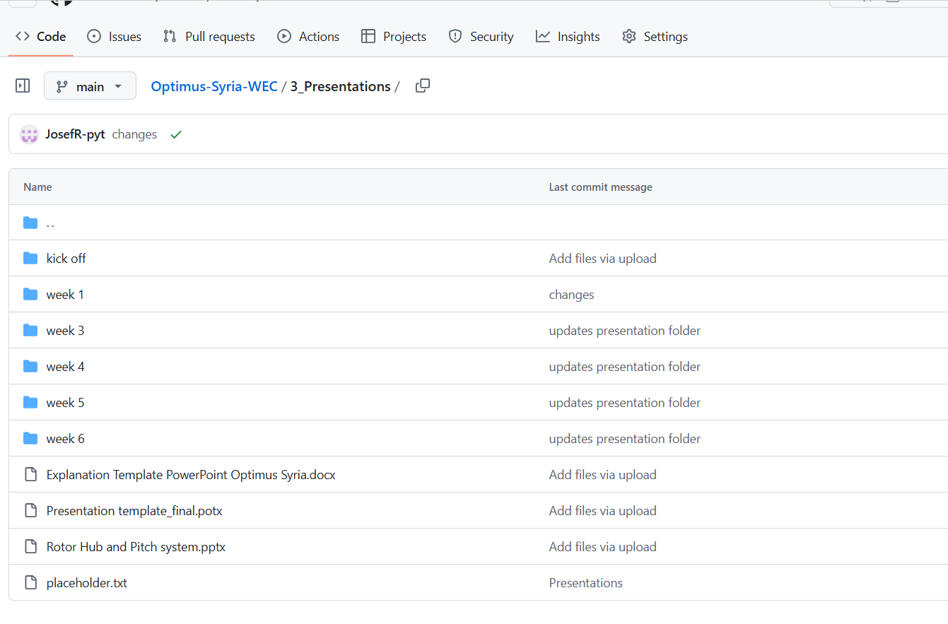
0. New additions to the presentation set up
The template for the presentations is finalized!!!
Now the template is fixed and the students are kindly asked to use it for their next presentations
https://github.com/Karim-bakhtyar/Optimus-Syria-WEC/tree/main/3_Presentations

Slide 6
1. Political distribution of Syrian forces
Syria is currently divided among multiple actors:
Syrian Government
Kurdish Syrian Democratic Forces
Turkish backed Syrian Rebels
Hayat Tahrir al-Sham (HTS)
US Military
Russian Military
Bakhtyar Karim

Slide 7
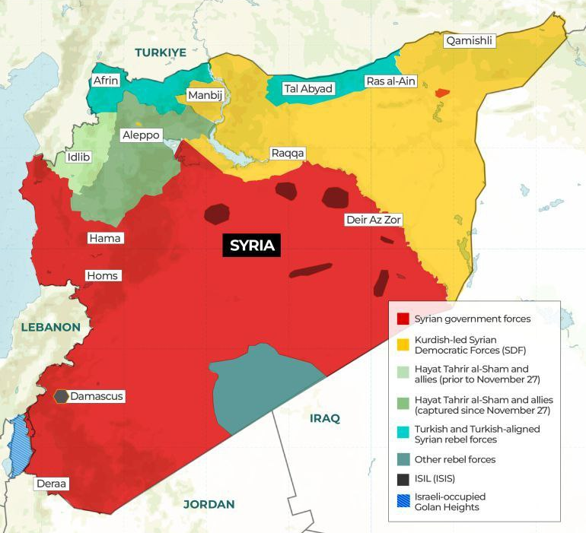

1.i Old vs New Syria
Political situation of Syria at the beginning December 2024, Al Jazeera, “Who controls what in Syria?”, 3 Dec 2024 [1], Last day of access 25th September 2025
Political situation of Syria at the end of December 2024, Alma Research and Education Center, “Territorial Control in Syria,” 30 Dec 2024. [2], Last day of access 25th September 2025
[1], [2]
Bakhtyar Karim

Slide 8
2. Locations for Wind Turbine Transport:
Location | Current Control | Risk Level
Latakia Port | Syrian Government / Russian | Low
Tartus Port | Syrian Government / Russian | Low
Idlib Region | HTS / Rebels | High
Aleppo (North) | Mixed: Govt + Turkish areas | Medium
Hama / Homs | Government | Low
Border Crossings | Turkish / HTS / Rebels | High
[1], [2]
Bakhtyar Karim

Slide 9
2.i Safe and unsafe locations:
Land Route | Maritime Route
Location: Idlib, Azaz, Western, Aleppo Under HTS or Turkish-backed rebels Outside Syrian government control → Unstable and unsafe Frequent airstrikes and clashes in Idlib corridor Unofficial checkpoints, extortion risks Customs issues, legal problems in contested zones | Location: Latakia port Latakia and Tartus are under full government control Russian naval presence ensures additional security Existing customs and port infrastructure Inland route to Hama → Homs → Project site is secure No rebel activity along this corridor
[1], [2]
Bakhtyar Karim

Slide 10
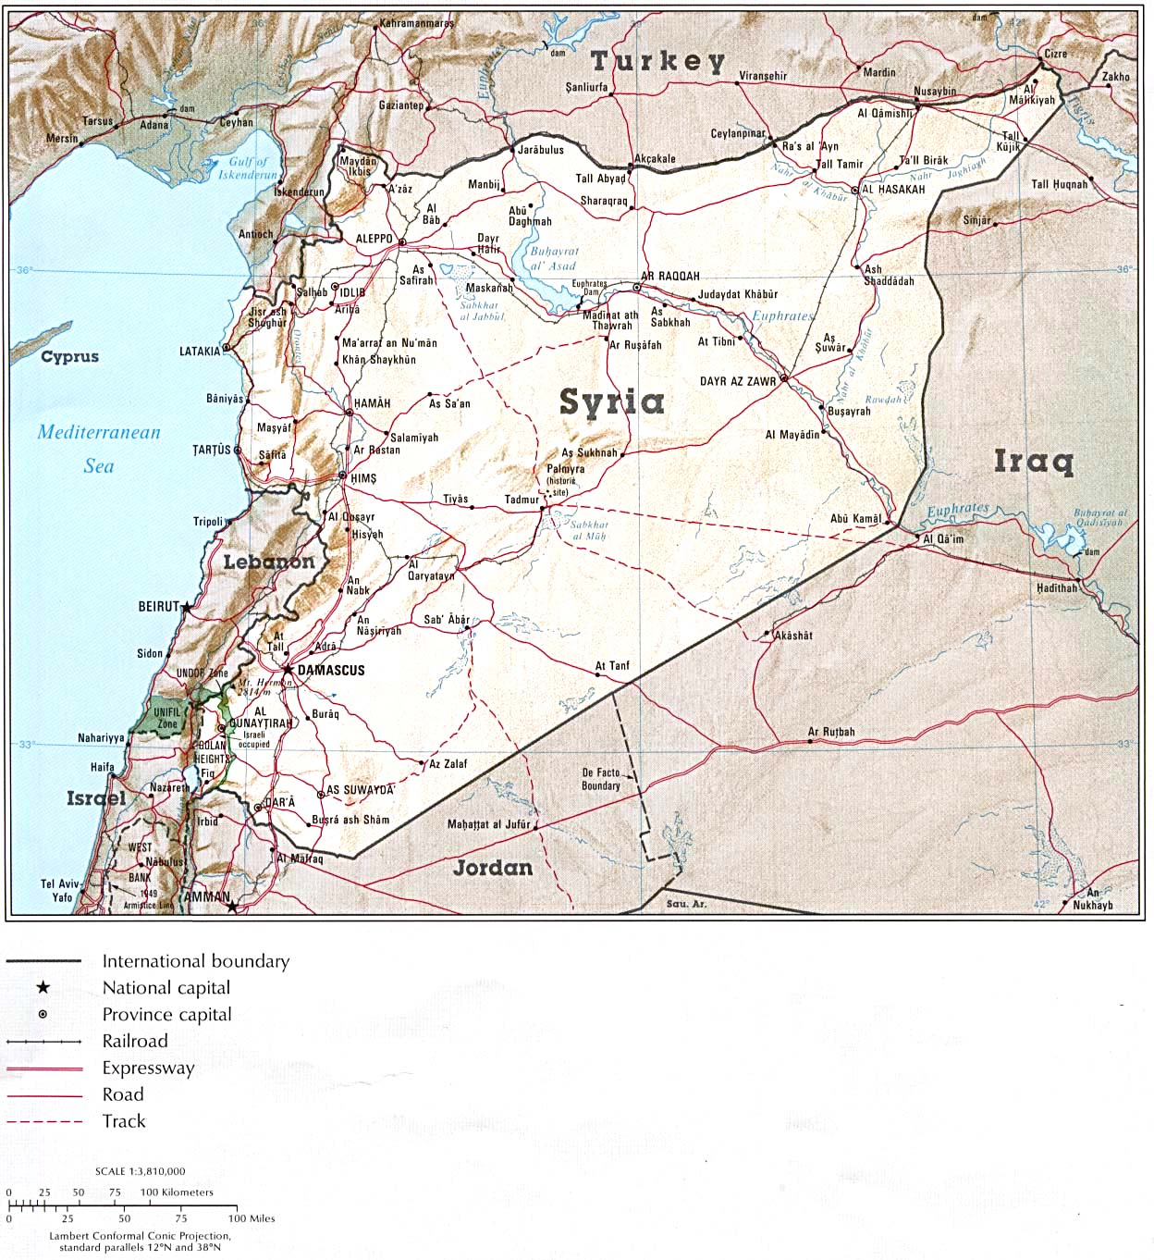
3. Transportation strategies
Option 1
Ship by sea to Latakia
Inland route through government controlled Hama and Homs
Legal, secure, and logistically sound
Option 2
Land crossing via Turkey area of Bab al-Hawa
Only small parts if unavoidable
Risk of delay, attack, or seizure by armed groups
[2]
Bakhtyar Karim

Slide 11
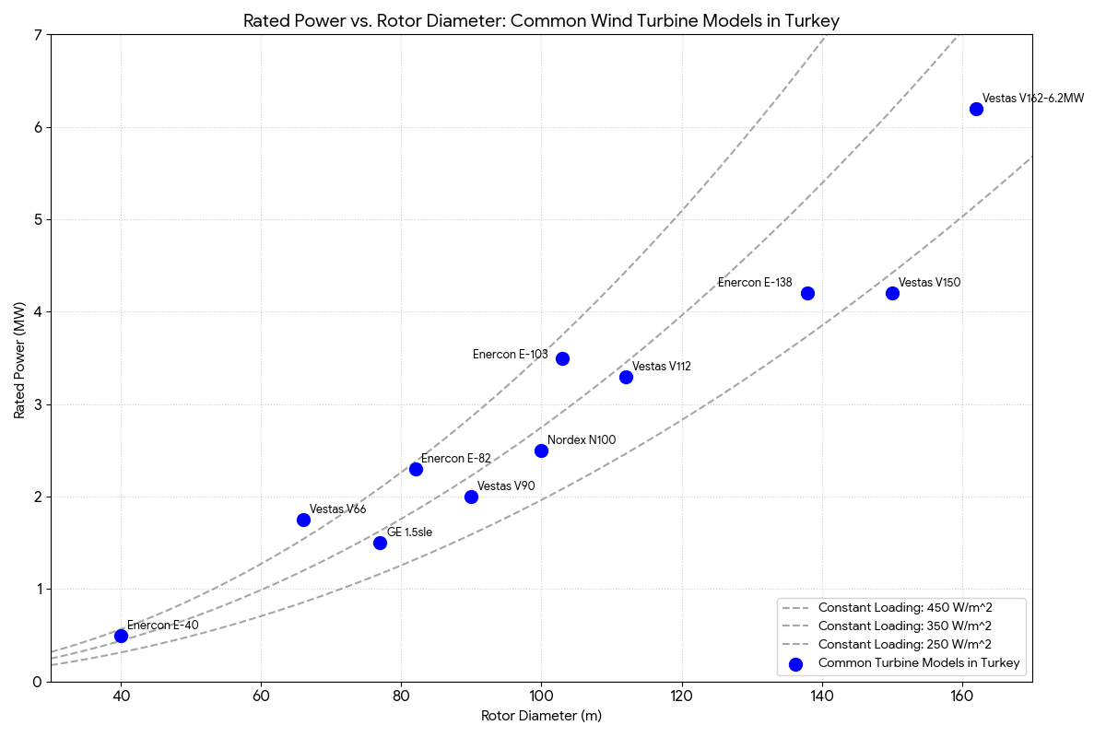
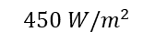
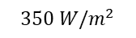
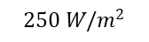
4. Analysis of rotor diameter changes
$$450 W/m^{2}$$
$$350 W/m^{2}$$
$$250 W/m^{2}$$
Rated power – rotor diameter curve for wind turbines in turkey [4]
[4]
Federico De Mita

Slide 12
4. Rotor diameter on different platforms
company | Platform name | Rotor diameter [m] | Main characteristics / drivers
Nordex | N169/5.X | 169 | Good performance for low to medium wind speed, taylor designed for US
Nordex | N149/5.X | 149 | High efficiency, high AEP, lower noise emissions
Siemens Gamesa | SG 5.0 – 145 | 145 | More robust quality and manufacturing process, used for medium wind sites
Enercon | E 160 EP5 | 160 | Good grid integration, robust construction, flexible design (tower height)
5.X Platforms from companies working in Turkey [5], [6], [7]
[5], [6], [7]
Federico De Mita

Slide 13
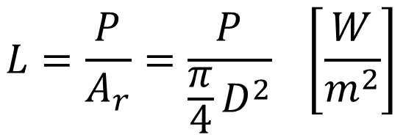
4. Reasons for diameter change
Mainly site conditions:
Different sites → different wind conditions → different rotor loadings
The higher diameter increases the amount of wind harvested by the turbine and, therefore, the wind kinectic energy and, as seen above, decreases the rotor loading
→ Diameter of the Optimus Syria will be chosen following the market trends in the rotor loading in the bordering countries
$$L=\frac{P}{A_{r}}=\frac{P}{\frac{π}{4}D^{2}} \left[\frac{W}{m^{2}}\right]$$
Federico De Mita

Slide 14
Weekly report: Team Project Development
Week number: 01
Date: 30/09/2025
Supervisor: Dr. Marina Blohm
Group members: Luis Urhahn, Ahmed Sallam, Ceren Cetin, Sohail Mansuri

Slide 15
List of content
Task of the week
Site selection – our approach
Site update
Site comaprison
Site suggestion (Project Development Team)
Sila Ceren Cetin-770819

Slide 16
1. Tasks of the week
Initial task defined by last weeks meeting + Mrs Blohm:
Define the final site for our project and explain why we choose the site.
New task due to updates during the week:
Comparing the new (official) sites for wind energy in Syria and decide if possibly better…
Sila Ceren Cetin-770819

Slide 17
2. Site selection – Our approach
I. Self-study on the topic and the country of Syria​
​
II. Initial meeting with Mrs. Blohm​
Getting a sight about how to choose a location.​
​
III. Searching for possible areas, considering…​
​
IV. Comparison of suitable areas​
Pros/Cons List for comparison​
Final decision on one area​
​
V. Finding a suitable/available site in the area​
​
VI. Confirmation meeting with Mrs. Blohm
Sila Ceren Cetin-770819

Slide 18
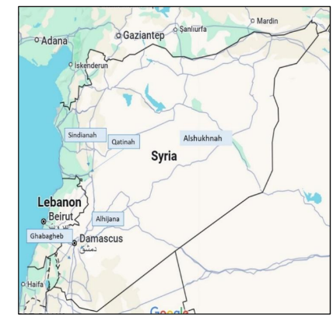
3. Site update
Getting a mail from Dr. Alhrshy about Request for Qualification (RFQ) issued by the Syrian Ministry of Energy / PETDE for a 100–200 MW Wind Farm Project in Syria.
Proposed Sites
Site 1: Qatinah Site – A flat open area
Site 2: Sindianah Site – A hilly open area
Site 3: Alhijana Site – An open desert area
Site 4: Ghabagheb Site – A hilly open area
Site 5: Alsukhnah Site – A high, open, and flat desert area
[1]
Sila Ceren Cetin-770819

Slide 19
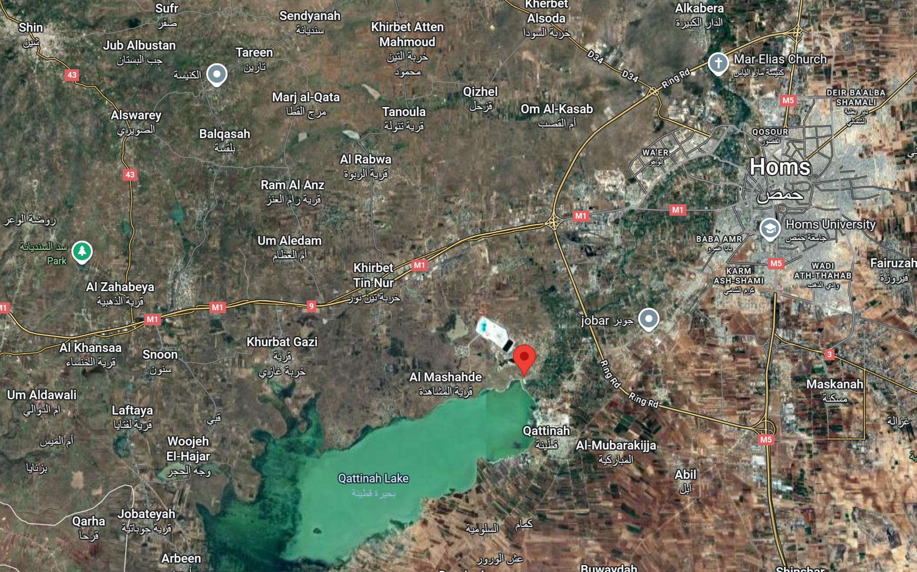
3. Site update - Qattinah
Initial location
New location
[2]
Sila Ceren Cetin-770819

Slide 20
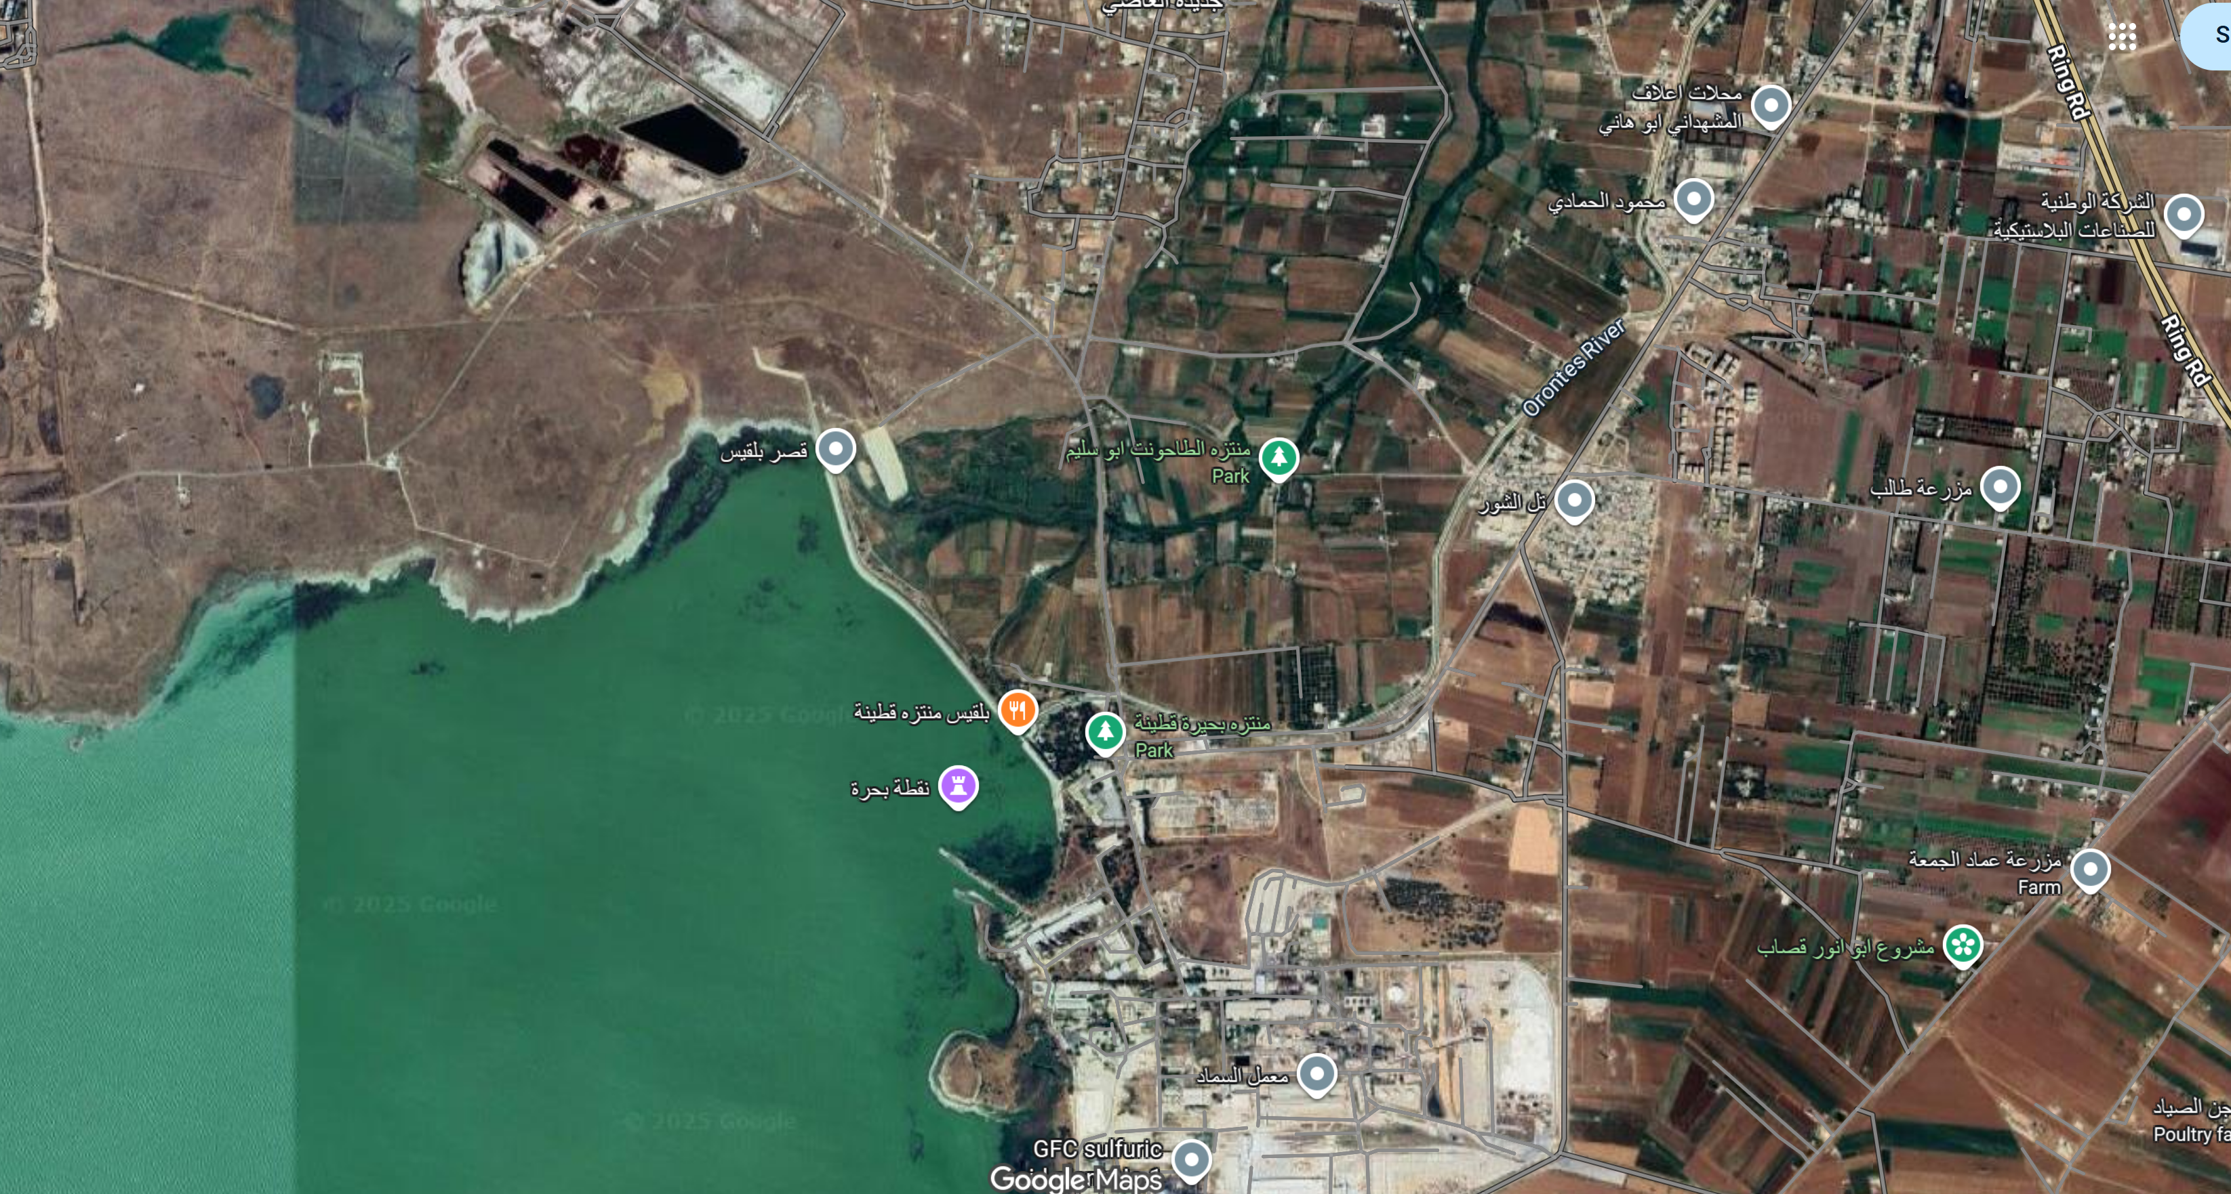
3. Site update - Qattinah
Substation
[2]
Sila Ceren Cetin-770819

Slide 21
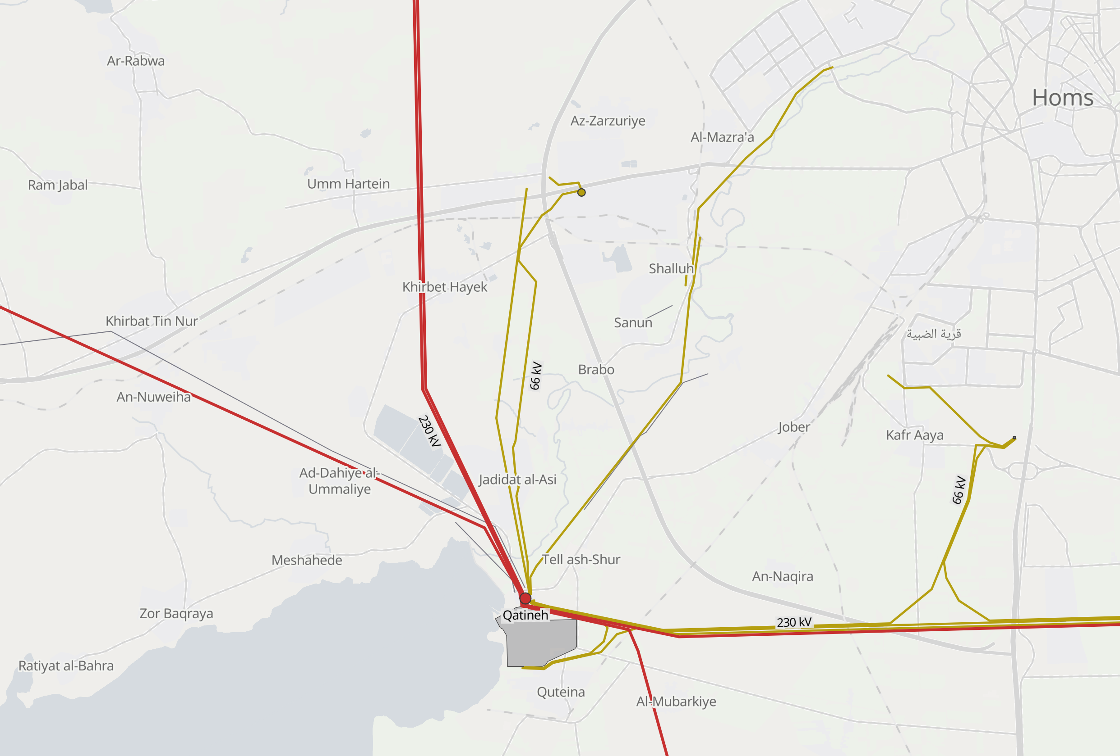
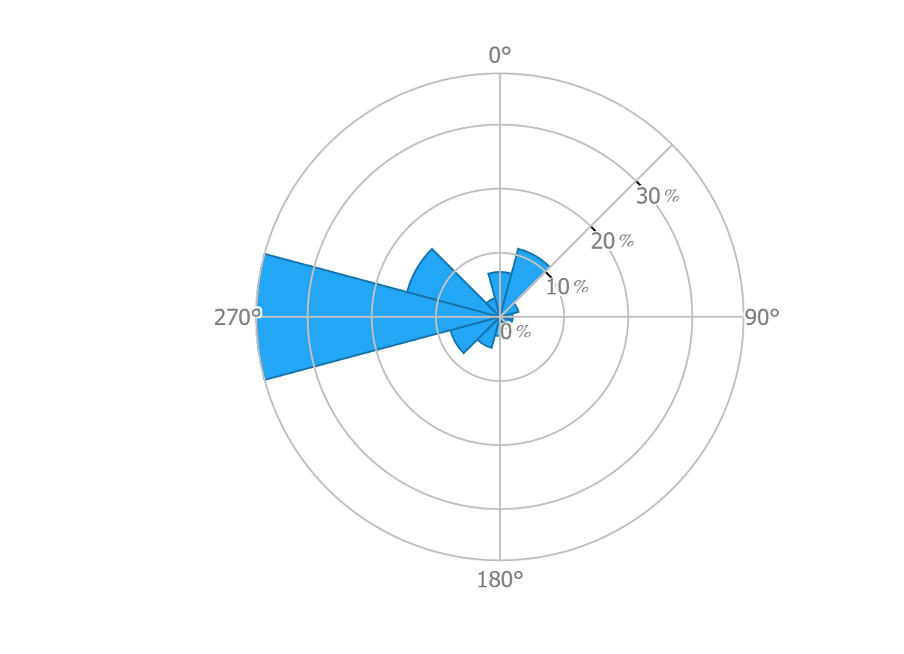
3. Site update - Qattinah
Wind Resource Data (at 100m HH) | Grid Connection
Main wind direction: 270° (west) | Grid connection: 66 kV and 230 kV
Average wind speed: 7.69 m/s | Distance to substation: < 5 km
Wind turbine class: III A | Distance to industry: < 15 km
Turbulence intensity: A
[1]
Sila Ceren Cetin-770819

Slide 22
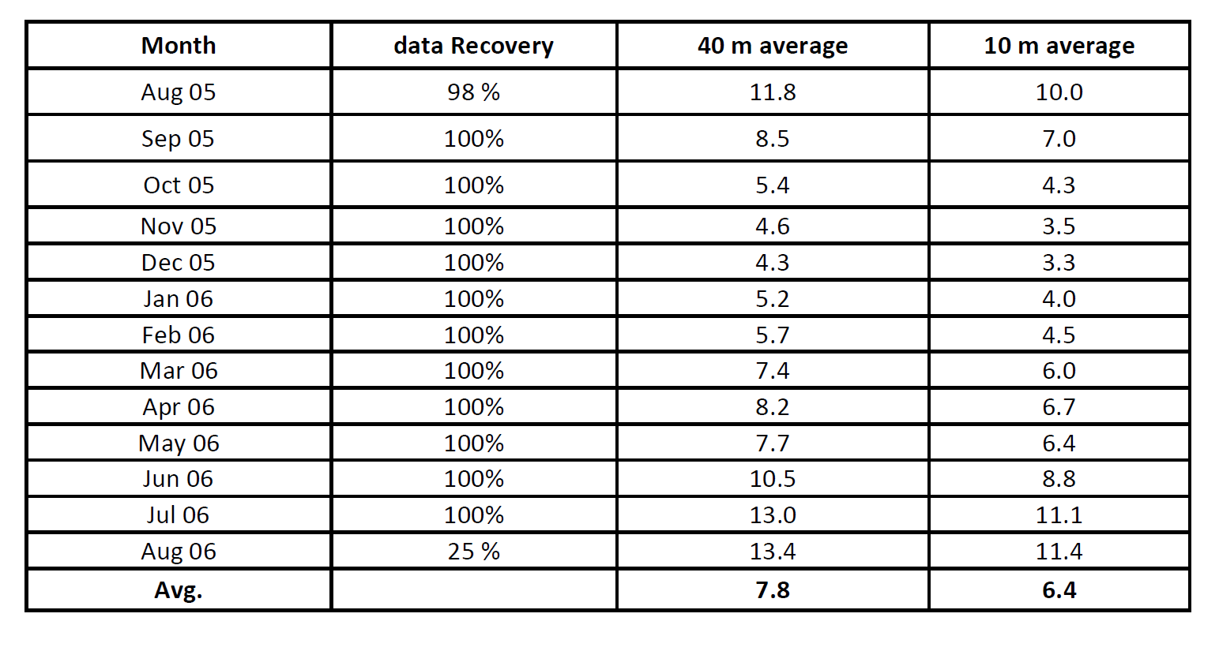
3. Site update - Qattinah
Wind resource data:
[1]
Sila Ceren Cetin-770819

Slide 23
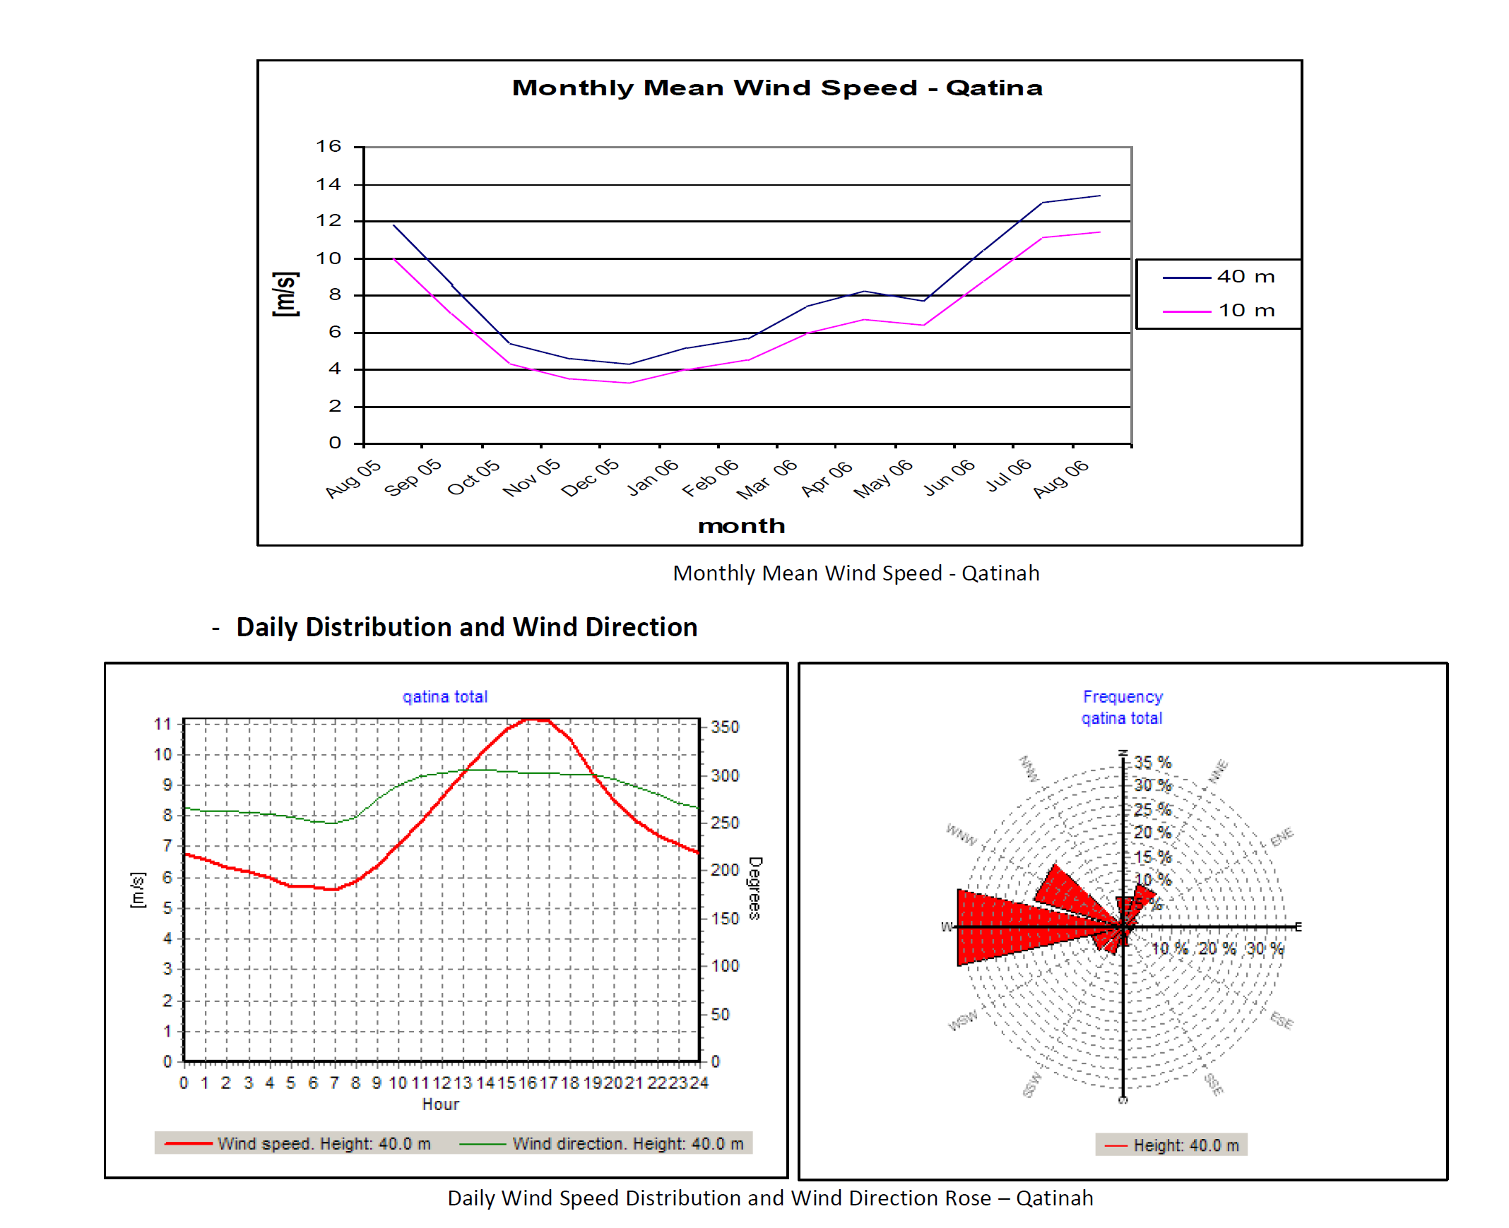
3. Site update - Qattinah
Wind resource data:
[1]
Sila Ceren Cetin-770819

Slide 24
3. Site update - Qattinah
Pros | Cons
+ Good wind conditions | - Complex transportation way, new street needed
+ 90% Wind direction from west (270°) | - Street conditions unknown
+ Tendered area, official area for wind energy | - Small bridges to the location
+ Relatively close to the highway M1 | - Very close to buildings, especially in main wind direction
+ Close to the city of Homs (Industry) | - Windspeed slightly smaller than site of Um Aledam
+ Good connection to the port of Tartus
+ Perfect grid connection (66 kV and 230 kV Grid)
+ Existing Substation within 5 km
+ Very flat terrain due to lake (no big turbulences)
→ The project can utilize the state-owned land within elevation levels 500–501 m A.S.L. Additional expansion is
possible by agreement with private landowners in the area.
[1]
Sila Ceren Cetin-770819

Slide 25
4. Site comparison
 | Um Aledam | Qattinah
Main wind direction: | 270° (West) | 270° (west)
Average wind speed: | 9.29 m/s | 7.69 m/s
Wind turbine class: | III A | III A
Distance to substation: | 10 km | 5 km
Grid connection: | 66 kV Substation | 66 kV and 230 kV
Distance to industry: | 20 km | < 15 km
[3]
Sila Ceren Cetin-770819

Slide 26
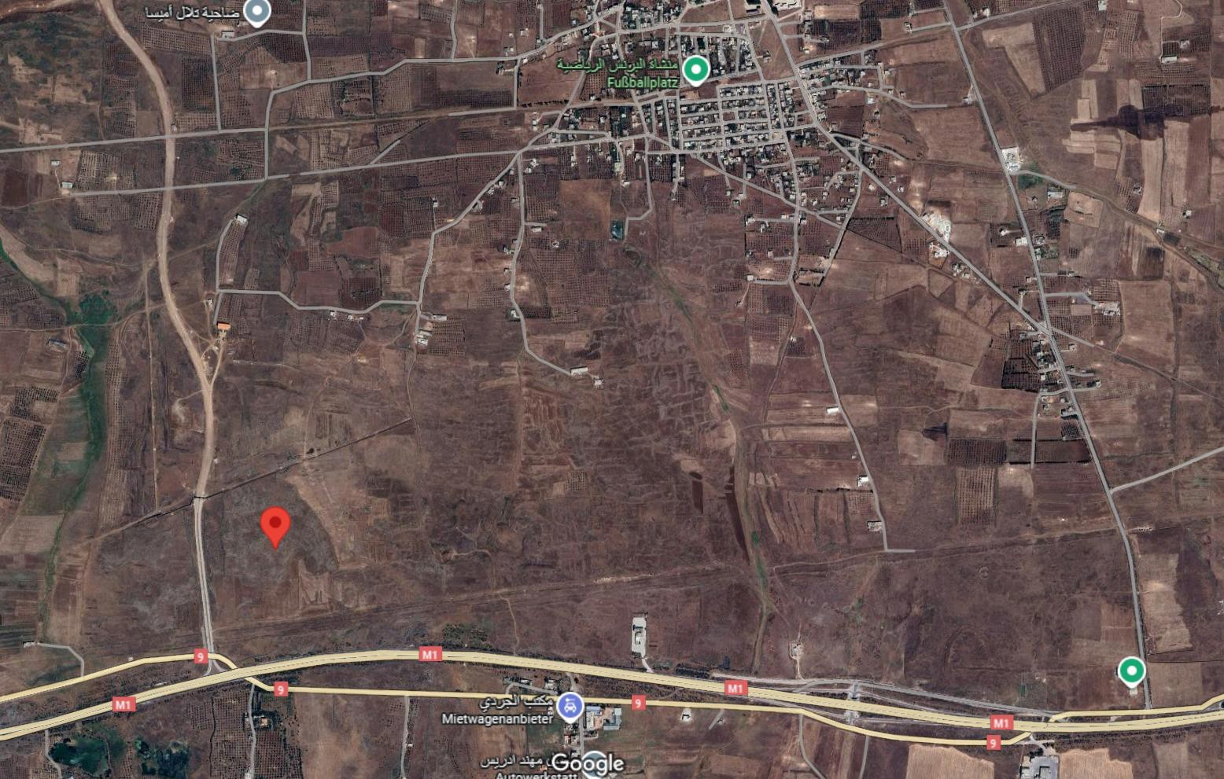
4. Site suggestion
We suggest : Um Aledam
Because of:
More wind capacity.
There are not any buildings so close.
[1]
Sila Ceren Cetin-770819

Slide 27



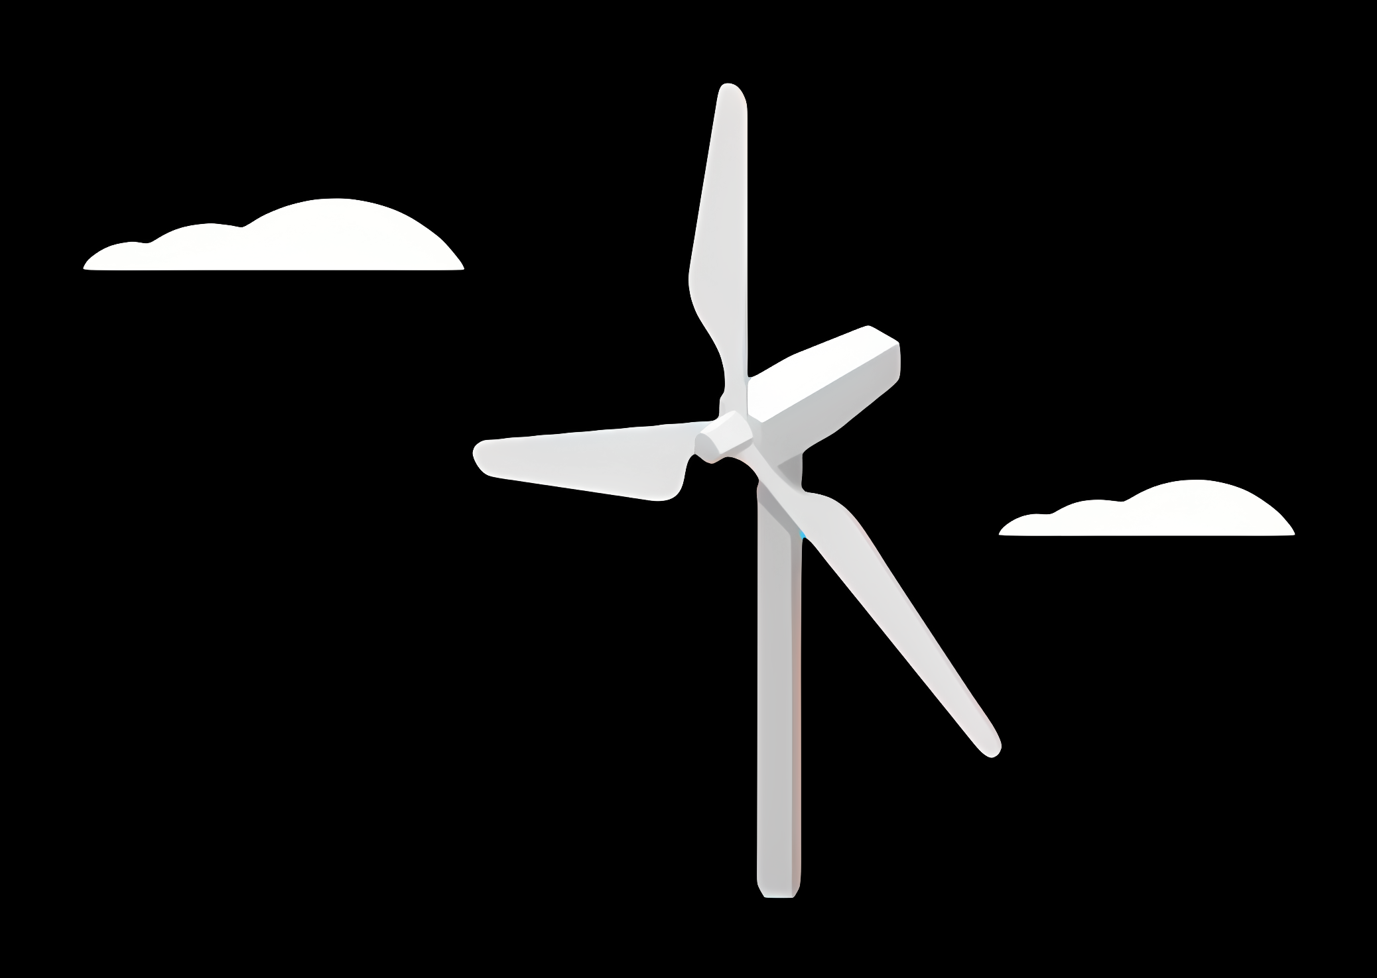
Weekly report: Wind Turbine Foundations
Week number:2
Date: 30/09/2025
Supervisor : Prof. Dr.-Ing. Torsten Faber
Group members: Jehad Albaali - Reda Deif- Amagad Gerges

Slide 28
Sharing of Work
Jehad Albaali
Leading the team
Making research of the sites and the soil Type
Preparation of reports
Prepare the power point with input
Amagad Gerges attended the meetings
Helping with research
Reda Deif
Helping with research
Writing the reports
Helping with power point Presentation

Slide 29
Foundation
Content
Foundation Types & Design Factors
Site Analysis
Soil Improvement
Reference

Slide 30
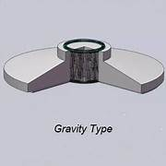
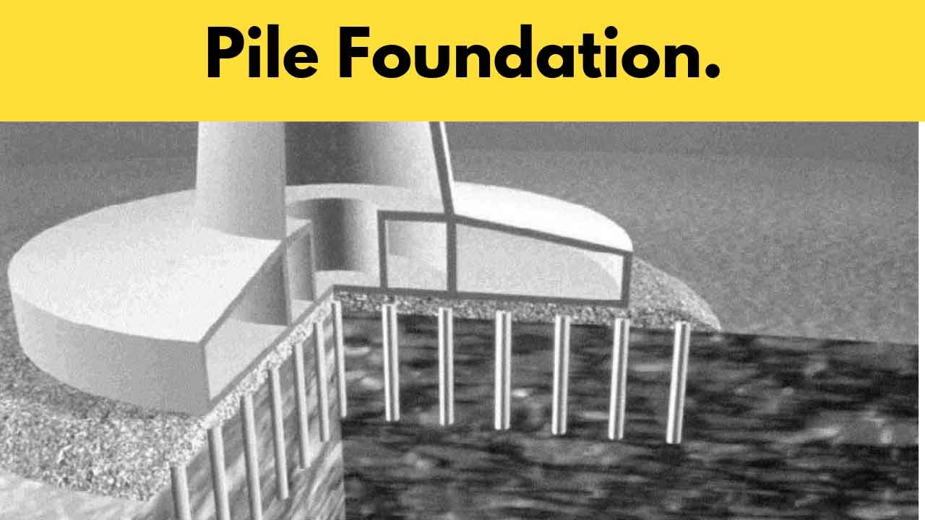
Foundation Types & Design Factors
• Shallow: Gravity, Piled raft
• Deep: Piles, Monopiles, Rock foundations
• Key factors: Soil type, Loads, Groundwater, Environment, Cost

Slide 31
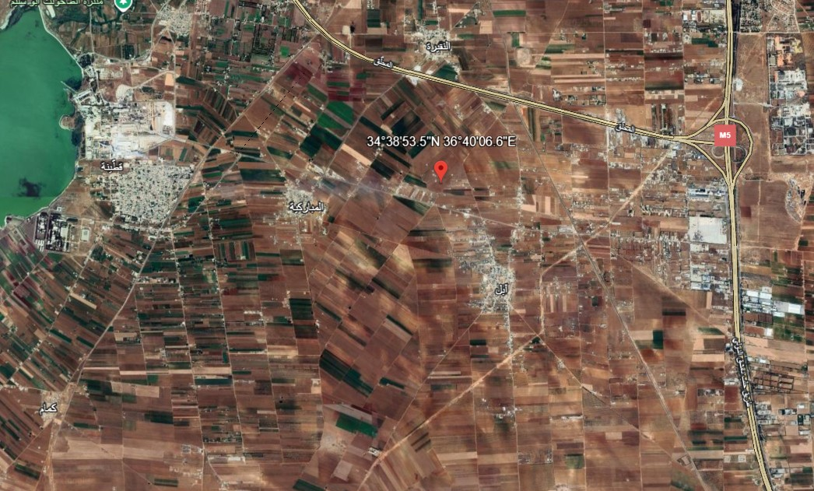
Site Analysis Qatina ,Umm Al-Azam and Ghabagheb.
• Qatina (34.6482°N, 36.6685°E): Clayey/Marly soil, weak bearing, high groundwater. Options: Piles or large gravity with ground improvement.

Slide 32
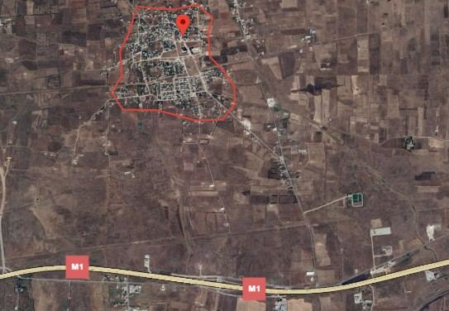
Site Analysis Qatina ,Umm Al-Azam and Ghabagheb.
• Umm Al-Azam (34° 4148.4" N 36° 3032.5" E): Clayey/Marly soil, weak bearing. Options: Piles or large gravity with ground improvement.

Slide 33
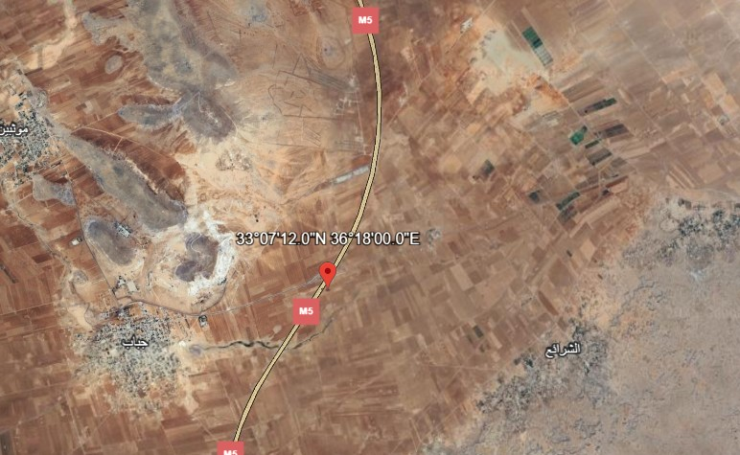
Site Analysis Qatina ,Umm Al-Azam and Ghabagheb.
• Ghabagheb (33.12°N, 36.30°E): Flat plains, clayey/loamy soils. Gravity foundations possible, piles if compressible.

Slide 34
Site Comparison – Soil & Topography
Site | Soil Type (SoilGrids) | Composition (Sand/Silt/Clay %) | Topography | Foundation Implications
Qahtina | Silty Clay | ~18–20 / ~33–37 / ~43–49 | Flat /plain | Weak soil → piles or improvement
Umm Al-Azam | Silty Clay | ~20 / ~35 / ~43–45 | Flat/plain | Weak soil → piles or improvement
Ghabagheb | Clay Loam – Silty Clay Loam | ~20–30 / ~30–35 / ~35–45 | Flat/plain | Piles or improvement

Slide 35
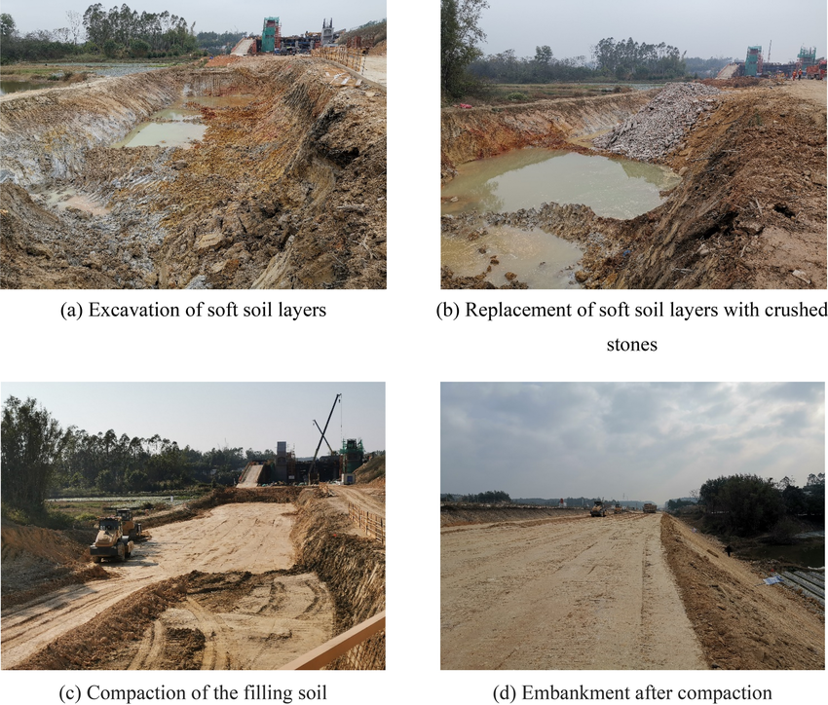
Soil Improvement for Gravity Foundations
• Soil Replacement: remove weak soil (2–3 m) and replace with compacted gravel/stone.
• Dynamic Compaction: drop heavy weights to densify soil (effective in sandy/silty soils).
• Stone Columns: drilled columns filled with compacted gravel → increase bearing + drainage.
• Grouting: inject cement/mortar to strengthen weak zones or voids.
• Geogrid Reinforcement: place geogrid under gravity foundation to spread loads.

Slide 36
Soil Improvement for Gravity Foundations
• Soil Replacement: remove weak soil (2–3 m) and replace with compacted gravel/stone.
• Dynamic Compaction: drop heavy weights to densify soil (effective in sandy/silty soils).
• Stone Columns: drilled columns filled with compacted gravel → increase bearing + drainage.
• Grouting: inject cement/mortar to strengthen weak zones or voids.
• Geogrid Reinforcement: place geogrid under gravity foundation to spread loads.

Slide 37
Next Tasks
Confirm the selected site for turbine installation.
Define the foundation type according to the tower design and soil conditions.
Coordinate with the loads team to obtain load figures (vertical, horizontal, overturning).
Prepare preliminary foundation sizing based on soil and load data.

Slide 38
Weekly report: Load & Dynamics
Week number: 02
Date: 30/09/2025
Supervisor: Mr. Manjock
Group members: Md Aman

Slide 39
Agenda
Typical load output sections
Design situations
Simulation Workflow
Needed parameters for the pre-processing
Coordinate systems and components
Estimated Loads for Optimus Syria based on statistics.

Slide 40
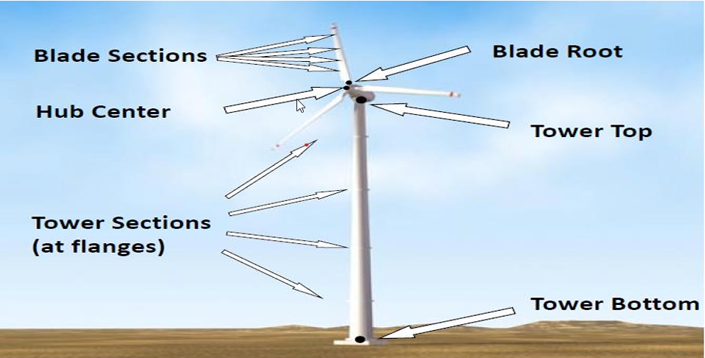
Typical load output sections
Load Output Sections Representation
Source : Load Simulation Seminar Mr. Manjock SS25

Slide 41
Design situations
Power production (DLC 1.X)
Power production + occurrence of fault (DLC 2.X)
Start up (DLC 3.X)
Normal shutdown(DLC 4.X)
Emergency stop (DLC 5.1)
Parked: Standing still or idling (DLC 6.X)
Parked and fault conditions (DLC 7.X)
Transport, installation, maintenance and repair (DLC 8.X)
Source :Loads and site conditions for wind turbines, DNVGL-ST-437,Edition November 2016

Slide 42
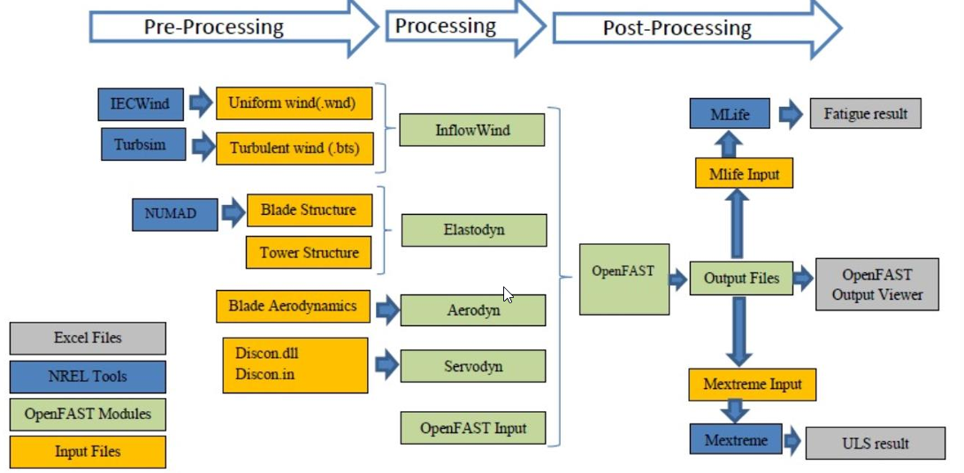
Simulation Workflow OpenFAST
Simulation Workflow
Source : Load report Optimus92 LE WS21

Slide 43
Needed parameters for the pre-processing
Site assessment:
Wind speed
Wind direction
Air density
Turbulence
Wind shear
Annual distribution
Tower:
Tower height
Mass distribution
Stiffness
Natural frequencies
Rotor blades:
Mass per unit length
Bending stiffness
Torsional stiffness
Natural frequencies
Material properties
Lift coefficient (Cl) and Drag coefficient (Cd) as functions of the angle of attack (AoA).
Blade twist and chord distribution along the blade.
Tip loss and hub loss correction factors
RNA Masses and inertias
Yaw bearing
Rotor Hub
Nacelle inertia about yaw axis
Generator
Control:
Pitch control gain values.
Generator torque control settings.
Set points for turbine operating conditions
Yaw control settings

Slide 44
Coordinate systems and components
Coordinate system | Affected components
Blade coordinate system | Rotor blade Rotor hub, Pitch system
Chord coordinate system | Rotor blade
Hub coordinate system | Rotor hub, Pitch system Rotor bearing system Gearbox, Brake, Coupling Machine Bed, Yaw system
Tower top coordinate system | Machine Bed, Yaw system Tower & Foundation
Support structure (tower) coordinate system | Tower & Foundation

Slide 45
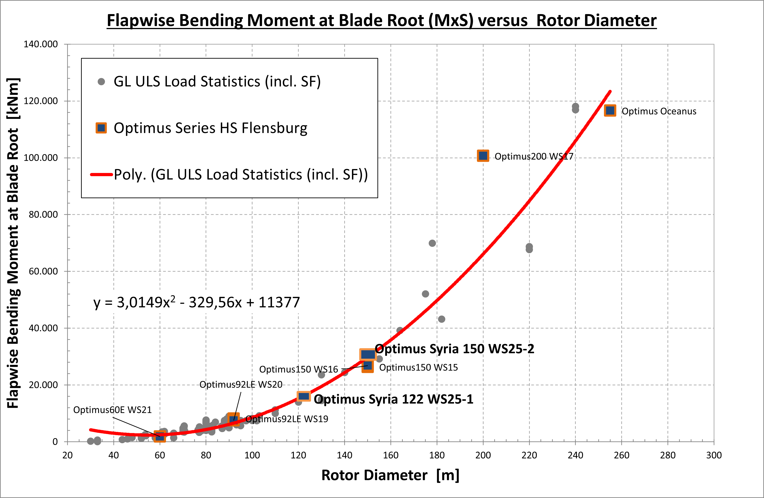
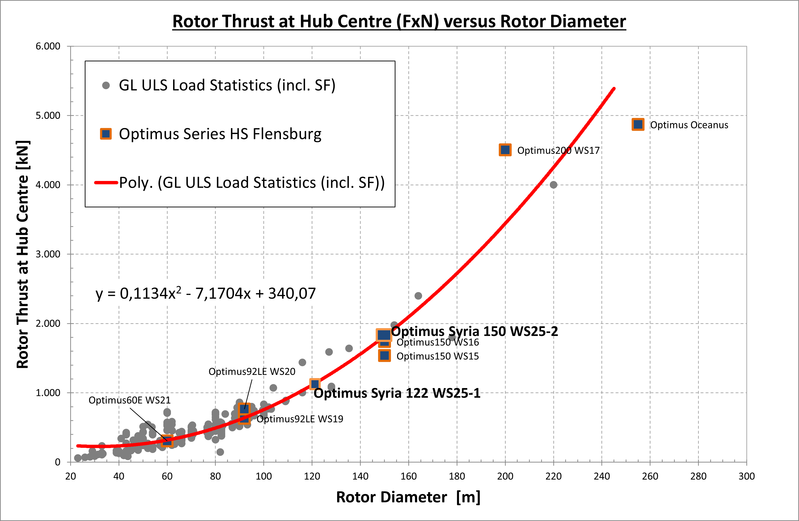
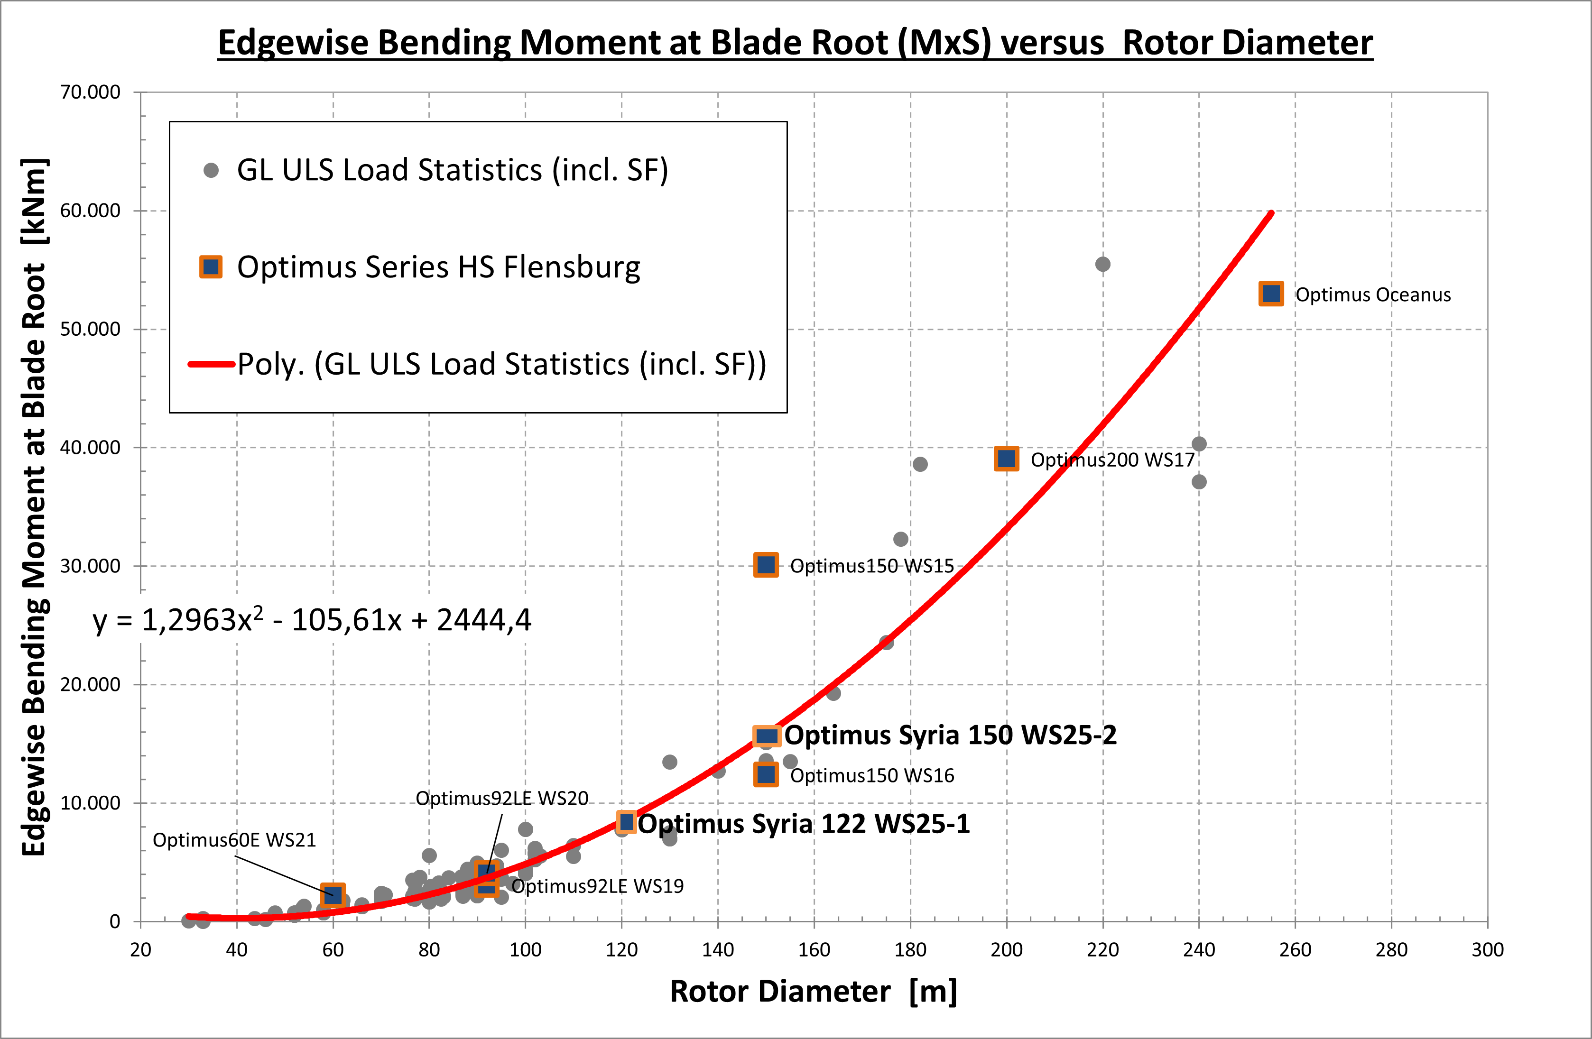
Estimated Extreme Loads for Optimus Syria

Slide 46
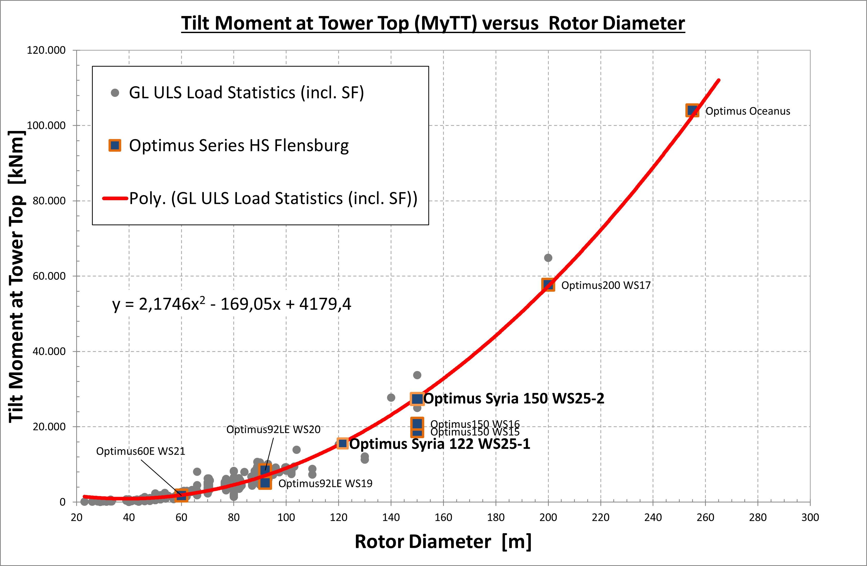
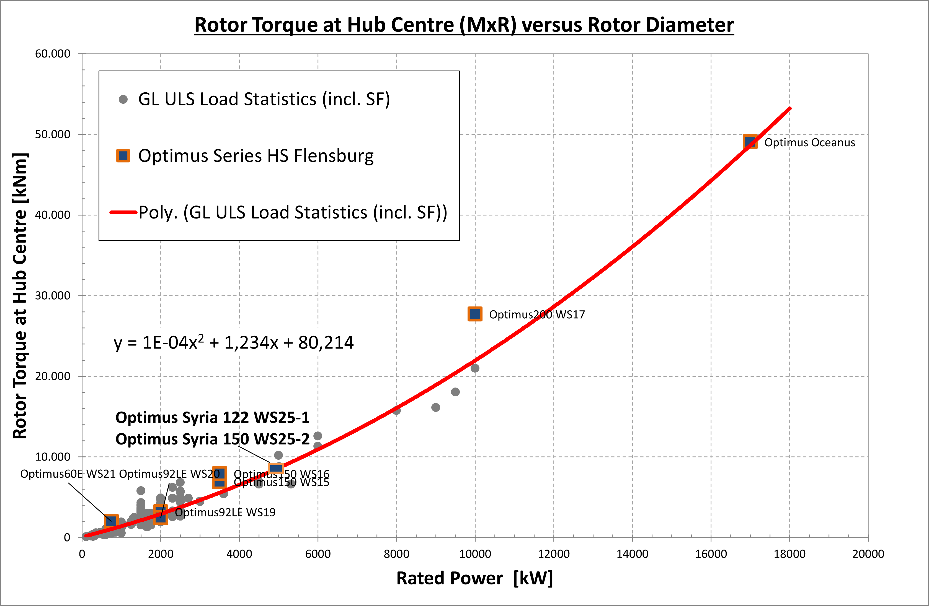
Estimated Extreme Loads for Optimus Syria

Slide 47
Estimated Extreme Loads for Optimus Syria
All values represent extreme loads (ULS) and already include the corresponding partial safety factors (γF).
 | Blade Edge moment | Blade Flap moment | Rotor thrust | Yaw Bearing Tilt moment | Rotor torque | Tower-bottom | Diameter | Tower height | Rated Power
 | kNm | kNm | kNm | kNm | kNm | kNm | m | m | KW
Optimus150 WS15 | 30,103 | 26,341 | 1,535 | 18,793 | 6,941 | 256,308 | 150 |  | 3,500
Optimus150 WS16 | 12,413 | 26,770 | 1,737 | 20,817 | 7,925 | 284,580 | 150 |  | 3,500
Optimus200 WS17 | 39,052 | 100,649 | 4,503 | 57,713 | 27,729 | 681,780 | 200 |  | 10,000
Optimus Oceanus | 52,998 | 116,570 | 4,872 | 103,990 | 49,073 | 1,189,800 | 255 |  | 17,000
Optimus92LE WS19 | 3,074 | 8,184 | 630 | 5,082 | 3,194 | 64,590 | 92 |  | 2,000
Optimus92LE WS20 | 4,070 | 7,495 | 764 | 8,432 | 2,471 | 86,020 | 92 |  | 2,000
Optimus60E WS21 | 2,204 | 1,872 | 304 | 1,708 | 2,005 | 28,567 | 60 |  | 750
Optimus Syria 1 | 8,854 | 16,044 | 1,153 | 15,922 | 8,500 | 120,000 | 122 | 90 | 5,000
Optimus Syria 2 | 15,769 | 29,778 | 1,816 | 27,750 | 8,500 | 28,2000 | 150 | 140 | 5,000

Slide 48
Weekly report: Tower structure
Week number: 02
Date: 30/09/2025
Supervisor: Prof. Faber
Group members: Ibrahim Mostafa, Mohammed Eldemerdash, Kirolls Ghaly
Speaker: Mohammed Eldemerdash (760137)

Slide 49
List of contents
Obstacles of the Transportation, for choosing the Tubular Steel structure.
Solutions to overcome transportation of the steel tower .
Handwritten load calculations and stress analysis based on data from NREL for a wind turbine with similar data.
Group members: Ibrahim Mostafa, Mohammed Eldemerdash, Kirolls Ghaly
Tower structure team/ Optimus Syria

Slide 50
1. Obstacles of the Transportation, for choosing the Tubular Steel structure.
Design vertical clearance (treaty): 4.90 m
Assume low-loader deck 0.80 m + 0.15 m tolerance ⇒ Max tower section Ø ≈ 4.0 m (route survey still required).
Ref:
AGREEMENT ON INTERNATIONAL ROADS IN THE ARAB MASHREQ
https://treaties.un.org/doc/source/RecentTexts/11_B_33E.pdf
the diameter at the bottom of the tower is 6m.
→ So transporting the Tower would be impossible using the highways in Syria.
Group members: Ibrahim Mostafa, Mohammed Eldemerdash, Kirolls Ghaly
Tower structure team/ Optimus Syria

Slide 51
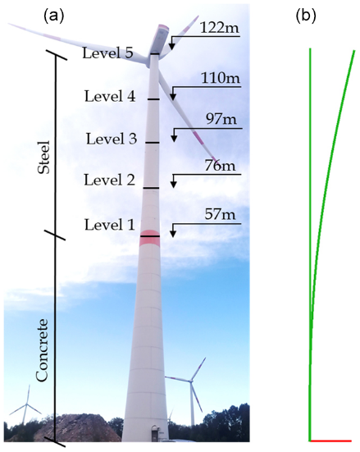
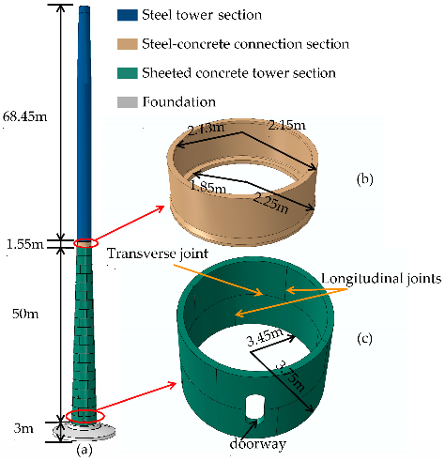
1- A Hybrid tower structure(Concrete bottom, Steel top). 2- Segments of Tubular steel with vertical connections.
For that we came up with two solutions
Fig 1,2: sketches of the hybrid tower concept
Group members: Ibrahim Mostafa, Mohammed Eldemerdash, Kirolls Ghaly
Tower structure team/ Optimus Syria

Slide 52
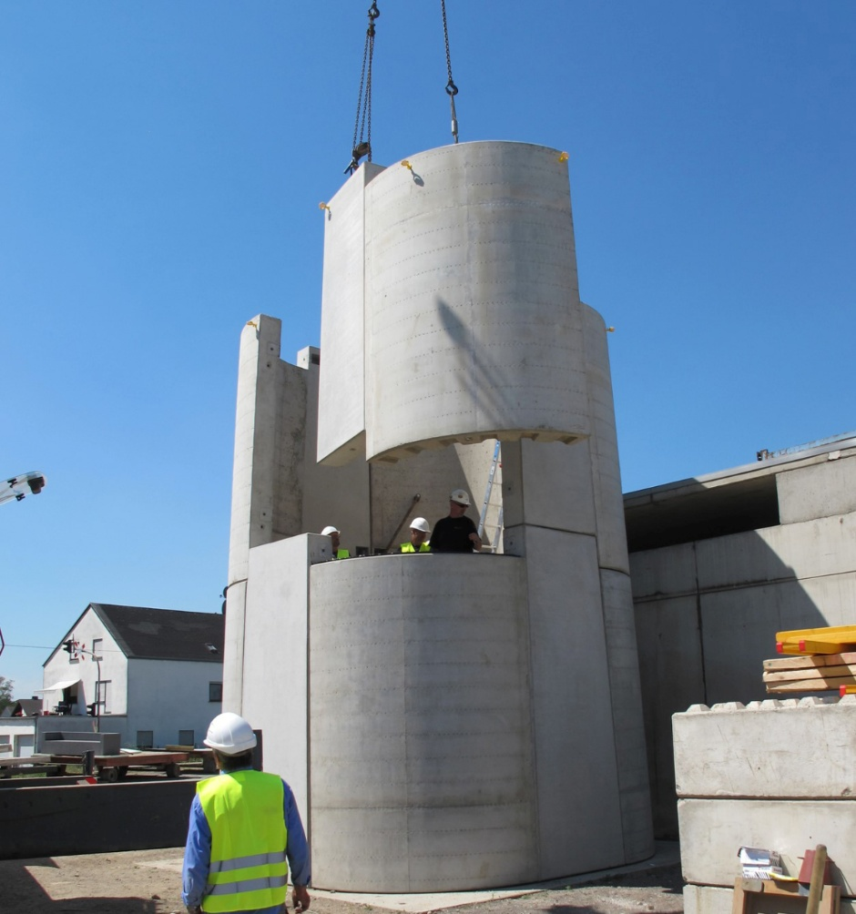
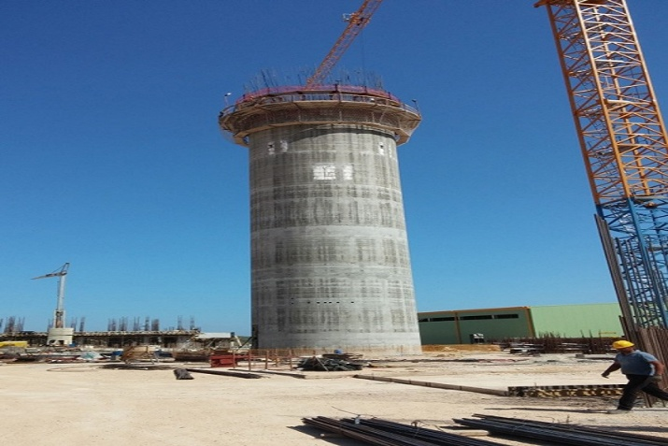
Fig 3: Precast concrete base (segmented) + tubular steel top
The two methods of erecting a hybrid Tower
Fig 4: Cast-in-situ concrete base (slipformed) + tubular steel top
Group members: Ibrahim Mostafa, Mohammed Eldemerdash, Kirolls Ghaly
Tower structure team/ Optimus Syria

Slide 53
- Difficult transport due to heavy, oversized concrete segment. - Long site erection time (formwork, pouring, curing). - Complex concrete-to-steel interface for structural continuity. - Harder inspection and maintenance at the base. - Permanent, less flexible; hard to adapt or modify. - Heavier lifting equipment required. - Less recyclable, harder to dismantle.
Hybrid tower drawbacks
Group members: Ibrahim Mostafa, Mohammed Eldemerdash, Kirolls Ghaly
Tower structure team/ Optimus Syria

Slide 54
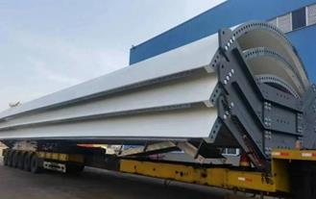
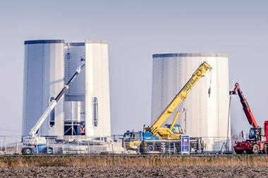
- folded steel “petals” bolted together along vertical seams segments are transported on standard trucks and assembled at site.
Segments of Tubular steel with vertical connections.
Fig 5 : Tubular steel tower segments
Fig 6 : Tubular steel tower construction
Group members: Ibrahim Mostafa, Mohammed Eldemerdash, Kirolls Ghaly
Tower structure team/ Optimus Syria

Slide 55
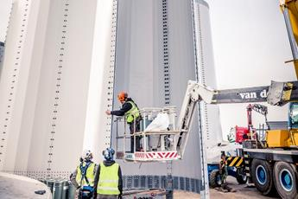
- Easier transport in smaller segments. - Faster erection, no curing time. - Simpler steel-to-steel joints (no hybrid interface). - Easier inspection and maintenance. - Lighter segments reduce crane demands. - Fully recyclable and adaptable supply chain.
Tubular steel segments with vertical connections
Fig 7: steel tower vertical connections
Group members: Ibrahim Mostafa, Mohammed Eldemerdash, Kirolls Ghaly
Tower structure team/ Optimus Syria

Slide 56
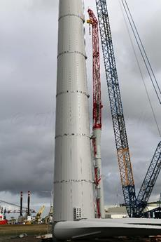
Tubular steel segments with vertical connections
Fig 8: tubular steel tower construction
Ref:
https://www.researchgate.net/
https://www.enercon.de/
Group members: Ibrahim Mostafa, Mohammed Eldemerdash, Kirolls Ghaly
Tower structure team/ Optimus Syria

Slide 57
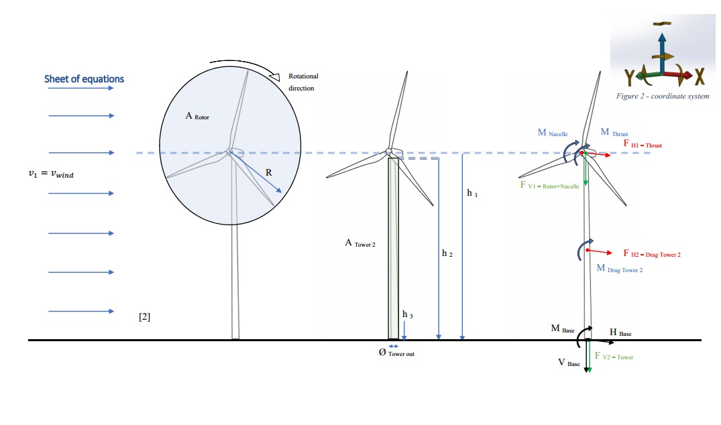
Loads calculations and stress analysis
Fig 9: how the different loads and moments affect the wind turbine
Group members: Ibrahim Mostafa, Mohammed Eldemerdash, Kirolls Ghaly
Tower structure team/ Optimus Syria

Slide 58
Loads calculations and stress analysis
Assumptions
𝜌_{air}=1.225 kg/m³
𝜌_{steel}=7850 kg/m³
(Wind class III) 𝑉=7.5 m/s
𝑔=10 m/s²
𝐷_{rotor}=160 m, 𝐷_{𝑜}=6.0 m, 𝑡=0.027 m
⇒ 𝐷_{𝑖}=5.946
𝐻_{tower}=98 m
ℎ_{hub}=100 m
𝐶_{𝑇}=0.9
𝐶_{𝐷}=0.01 ​
𝑚_{rotor}=110,000 kg
𝑚_{nacelle}=240,000 kg
𝑚_{RNA}=350,000 kg
𝑀_{nacelle}=4200 kN
Reference to data assumptions:
https://www.nrel.gov/wind/data-tools
Group members: Ibrahim Mostafa, Mohammed Eldemerdash, Kirolls Ghaly
Tower structure team/ Optimus Syria

Slide 59
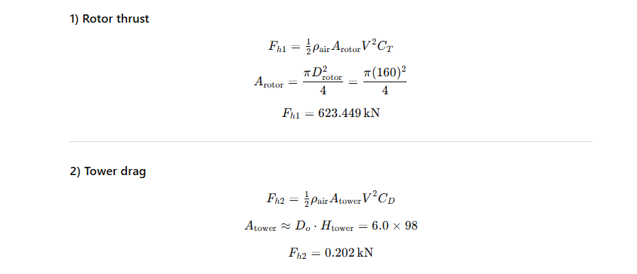
Loads calculations and stress analysis
Group members: Ibrahim Mostafa, Mohammed Eldemerdash, Kirolls Ghaly
Tower structure team/ Optimus Syria

Slide 60
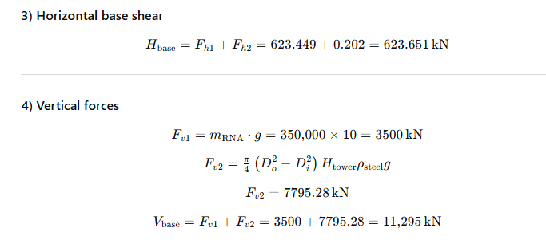
Loads calculations and stress analysis
Group members: Ibrahim Mostafa, Mohammed Eldemerdash, Kirolls Ghaly
Tower structure team/ Optimus Syria

Slide 61
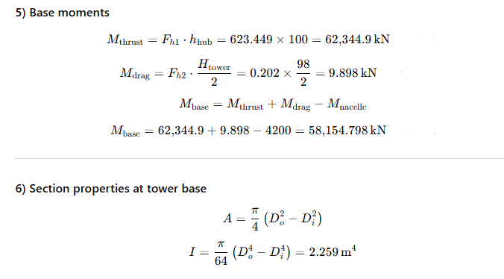
Loads calculations and stress analysis
Group members: Ibrahim Mostafa, Mohammed Eldemerdash, Kirolls Ghaly
Tower structure team/ Optimus Syria

Slide 62
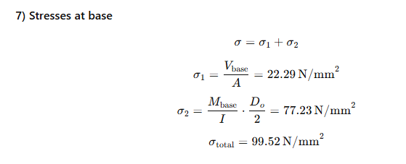
Loads calculations and stress analysis
Group members: Ibrahim Mostafa, Mohammed Eldemerdash, Kirolls Ghaly
Tower structure team/ Optimus Syria

Slide 63
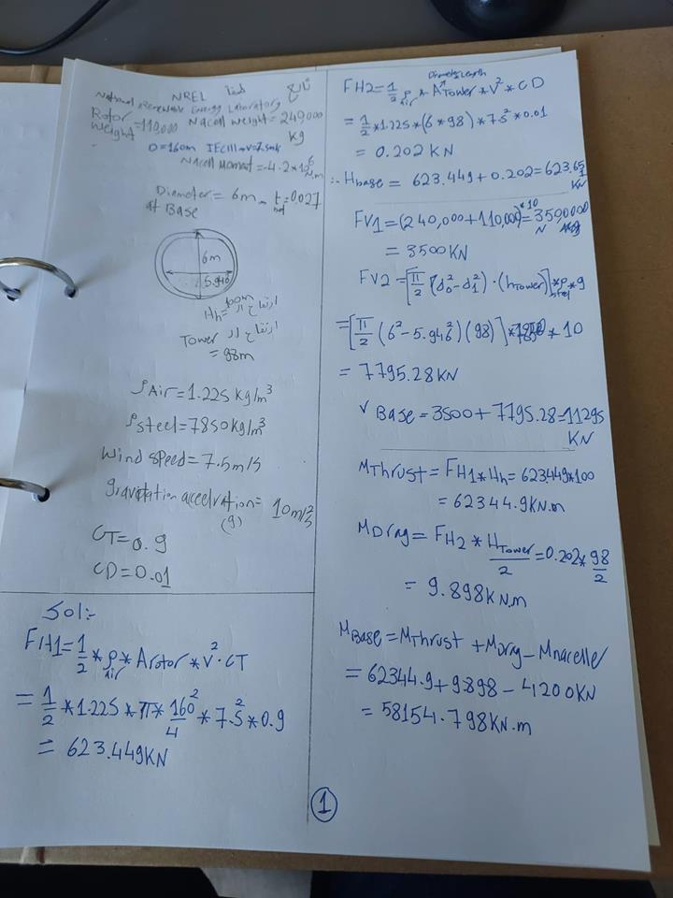
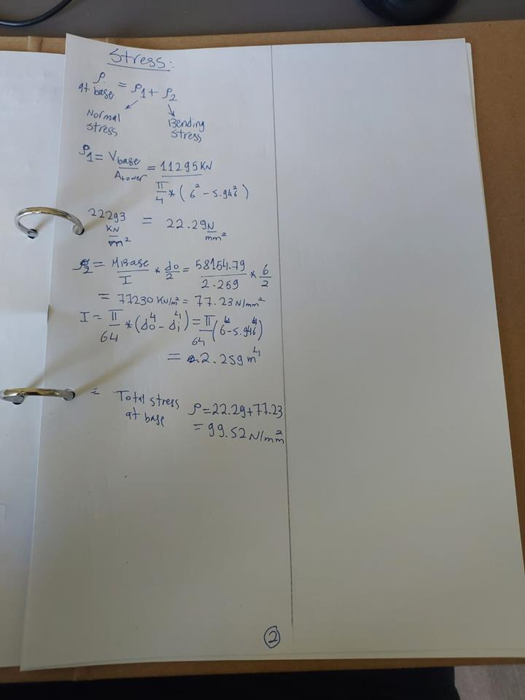
Loads calculations and stress analysis
Fig 10,11: Original handwritten calculations
Group members: Ibrahim Mostafa, Mohammed Eldemerdash, Kirolls Ghaly
Tower structure team/ Optimus Syria

Slide 64
work distribution
Mohammed Eldemerdash:
loads and stress calculations.
Editing and presenting.
Ibrahim Mostafa:
Revision of the calculations.
Finding solutions for transportation of the steel tower.
Kirollos Ghaly:
- no input
Group members: Ibrahim Mostafa, Mohammed Eldemerdash, Kirolls Ghaly
Tower structure team/ Optimus Syria

Slide 65

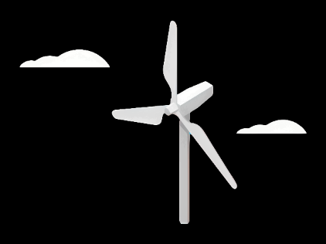
Weekly Report: Rotor Blade Design
Week number: 02
Date: 30.09.2025
Supervisor: Prof. Dr. rer. nat. Alois Schaffarczyk
Group Members: Jay Pandya, Kandarp Pathak, Harsh Panchal, Daniyal Sikandar

Slide 66
NREL 5 MW Reference Blade
> INTRODUCTION:
• Developed by NREL (National Renewable Energy Laboratory)as a reference offshore turbine
• Rated power is 5 MW
• Rotor diameter is 126 m, and Hub height is 90 m
• Provides standardized geometry and airfoil data
• Widely used in research for load calculations, simulations, and design studies
> Used For:
Load calculations
Aeroelastic simulations
Design comparisons
Academic and industrial research

Slide 67
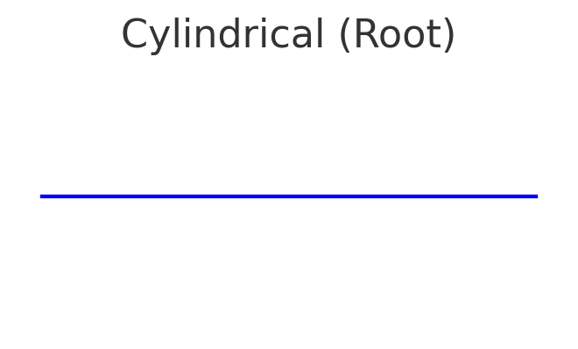
Airfoils Used in NREL 5 MW Blade
> Blade Section Division
•Root region (0–17% span)
• Mid-span region (~17–80% span)
• Tip region (~80–100% span)
> Root Region (0–17% span)
• Cylindrical profile (non-lifting)
• Structural strength and manufacturability
• Smooth transition hub → aerodynamic section

Slide 68
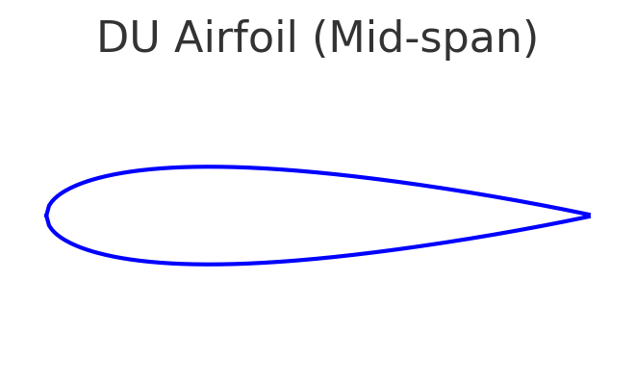
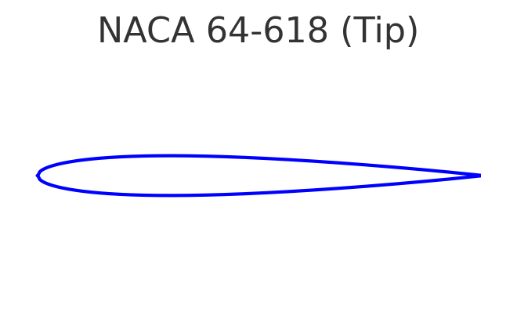
Airfoils Used in NREL 5 MW Blade
> Mid-span Region (~17–80% span)
• DU airfoils (DU21-A17, DU30-A17, DU35-A17, DU40-A17)
• Thick (17–40% thickness-to-chord)
• Structural stiffness and aerodynamic efficiency
> Tip Region (~80–100% span)
• NACA 64-series (NACA 64-618)
• Thin, low-drag
• Reduces aerodynamic losses, noise, stall sensitivity
• Optimized for high Reynolds numbers

Slide 69
Aerodynamic Guidelines (Syria)
Maintain precise aerodynamic surface contours (chord length, thickness, and twist angle) to ensure stable performance across variable wind speeds.
Use enhanced leading edge erosion protection (hard coatings, erosion tapes) to resist sand and dust abrasion from desert winds.
Check and verify blade profiles for operation across the expected Reynolds number range for local wind speeds.
Perform regular aerodynamic load comparisons and checks to ensure compliance with design specs under gusty desert winds.
Consider low maintenance surface finishes to reduce the frequency of on site repairs in remote locations.
Include noise reduction design measures where turbines will be near villages or agricultural areas.

Slide 70
Key Guidelines for Syrian Conditions
High-temperature resistance: select materials, adhesives and coatings rated for sustained high summer temperatures (commonly >35°C in many regions).
Erosion resistance: robust leading edge protection and replaceable erosion strips to cope with sandstorms and abrasive dust.
Dust and sand management: design features and maintenance plans that reduce dust ingress and abrasion (e.g., protective seals, scheduled inspections after storms).
Structural reinforcement: consider local gust factors and higher stiffness or tailored spar sizing to control tip deflection and avoid tower strikes.
Low-maintenance design: favour durable coatings and modular replaceable parts since remote desert sites can be hard to access frequently.
Lightning protection: include appropriate lightning protection even if storms are infrequent mountain/coastal sites may still experience thunderstorms.
Thermal cycling durability: verify long term performance of composites and adhesives under repeated heating and cooling cycles.
Site verification: finalize designs after analyzing site specific wind data (mean wind speeds, extreme gusts, turbulence intensity) and local environmental reports.

Slide 71
Week 2 – Work Done
.
Tasks Completed:
Learned about the functions of the Q Blade.
Used data from the previous week’s PPT to perform hand calculations.
Found that the blade length from the calculation was 35 m.
Challenges:
Unsure how a 35 m blade can generate 5 MW.
The calculation result seems incorrect.
Need updated load data to continue the design.
Next Steps:
Request corrected load data from the load team, as instructed by the professor.
Include corrected calculations in the report.
Collect data from project manager to design a 5 MW turbine.

Slide 72
Weekly Report: Rotor Blade Structures
Week: 01
Date: 23/09/2025
Supervisor: Prof. Dr. Laurence Alhrshy
Group members: Bhima Masare, Dongsuk Kim, Anudeep Allanki, Mithun Shetty

Slide 73
Steps Planned during the Project Phase –
Define Blade Geometry
Material Selection
Structural Layout & Component Design
Finite Element Modelling
Load Analysis & Simulation
Performance Verification & Optimization
Reference –
5 MW/61.5m Wind Turbine Blade Reference Model by Brian R. Resor, Sandia National Laboratories, California, USA

Slide 74
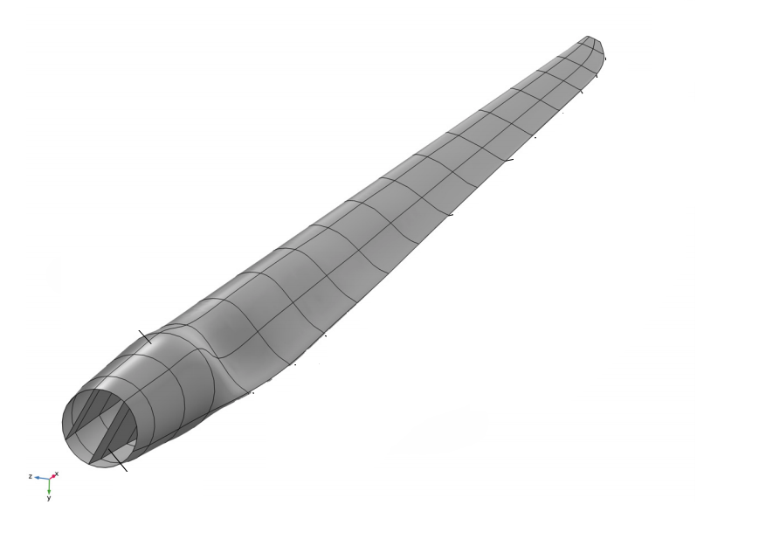
Step 1 - Define Blade Geometry
Use existing models (i.e. Brian Resor 5MW/61.5m, NREL 5MW) as reference models
Incorporate Air foil shapes, chord distribution, and blade length with help of Team Blade Aerodynamics
Adjust tip and root geometries considering structural requirements from other Teams
Ensure compatibility with manufacturing constraints with the current Industrial Standards

Slide 75


Step 1 - Define Blade Geometry
$$P_{w}=\frac{1}{2}×C_{p}×ρ×A×v_{1}^{3}$$
Substituting the values -
$$P_{w}=5 MW$$
$C_{p}=$0.45
$ρ=$1.225 kg/m³
$v_{1}=$9.29 m/s
$$A= \frac{π}{4}d^{2}$$
We get –
D = 170 m
R = 85 m

Slide 76
Step 1 - Define Blade Geometry
Cylinder 1 - inboard root cylinder (no lift, Cd ≈ 0.50) (blade nodes 1–2)
Cylinder 2 - inner cylinder (no lift, Cd ≈ 0.35) (node 3)
DU40_A17 - (node 4)
DU35_A17 - (nodes 5–6)
DU30_A17 - (node 7)
DU25_A17 - (nodes 8–9)
DU21_A17 - (nodes 10–11)
NACA64_A17 - (nodes 12–17, tip region)

Slide 77

Step 1 - Define Blade Geometry
Source - Definition of a 5 MW/61.5m Wind Turbine Blade Reference Model by Brian R. Resor

Slide 78


Step 1 - Define Blade Geometry
Source - Definition of a 5 MW/61.5m Wind Turbine Blade Reference Model by Brian R. Resor

Slide 79
Bibliography
Definition of a 5 MW/61.5m Wind Turbine Blade Reference Model by Brian R. Resor, Sandia National Laboratories, California, USA
Definition of a 5 MW Reference Wind Turbine for Offshore System Development, J. Jonkman, S. Butterfield, W. Musial, and G. Scott, National Renewable Energy Laboratory, USA

Slide 80



Rotor Hub And Pitch System
Group Members :
Dhruvin Kakdiya
Adharsh Pappinisseri Veedu
Muthu Thirunavukarasu
Syed Mohammed Sikandar
Week number : 02
Date: 30/09/2025
Supervisor: Prof. Peter Quell

Slide 81
Agenda
Comparison of Hub shape
Selection of Hub
Comparison of a pitch system
Selection of a pitch system
List of parts
Presented by: Adharsh Pappinisseri Veedu - 770483

Slide 82


Shapes of Hub
Now a days there are two types of Hub shape is commonly use:
Star Shape Hub
Sphere Shape Hub

Slide 83
Rotor Hub Shape Comparison
Category | Star Shape Hub | Sphere Shape Hub | Result
Aerodynamic Efficiency | Moderate - more drag due to protrusions and edges | High - smoother surface, lower drag, reduced turbulence | Sphere Shape
Structural Simplicity | High - direct load paths, simple geometry | Moderate - curved shapes require complex internal support | Star Shape
Manufacturing Ease | Easy - simpler to cast, weld, or machine | Complex - harder to fabricate due to curves and internal transitions | Star Shape
Maintenance Access | Easy - accessible joints at blade roots | Harder - may require disassembly or special tools | Star Shape
Fatigue Resistance | Good - but stress concentrations at blade root junctions | Excellent - smoother load distribution reduces fatigue cracks | Sphere Shape
Weight | Lighter - less material due to simpler design | Heavier - more material for smooth integration and strength | Star Shape
Cost | Lower - materials, labor, and tooling costs are minimal | Higher - due to design and fabrication complexity | Star Shape
Suitability (Onshore) | Very suitable - proven and practical | Less common - unless specific goals are targeted | Star Shape
 |  | Overall for Optimus Syria | Star Shape

Slide 84

Hydraulic Pitch Control System
Uses Hydraulic fluid to change blade angle and offer high power density and fast reaction times
Preferred for Large turbines needing high torque and robust performance
Long lifespan but needs regular maintenance to prevent failures
Risk of fluid leaks with environmental impact

Slide 85

Electric Pitch Control System
Uses electric motors for blade pitch and delivers high control and accuracy
Low logistics
Higher energy efficiency and reduced environmental impact
Ideal for environmental sensitive or remote sites with limited maintenance resources

Slide 86
Weighted Evaluation of Pitch Control Systems
Criteria | Weightage | Electrical Pitch | Hydraulic Pitch
Low investment cost | 28% | 3 | 2
High torque | 10% | 2 | 3
Reliability | 14% | 3 | 3
Accuracy/Control process | 12% | 3 | 2
Low Maintenance effort | 14% | 3 | 1
Weight | 8% | 3 | 2
Low Energy Consumption | 8% | 3 | 1
Simple Design | 6% | 3 | 2
Sum | 100% | 84% | 64%

Slide 87
Why Choose Electric over Hydraulic?
Easier to service locally with standard electric skills and no need for hydraulic specialists
No Hydraulic oil→ no leaks or contamination risk in hot, dusty environment
Standard motor/controllers are widely available and cheaper to stock than hydraulic parts
Handles high ambient temperatures and dust reliably with IP-rated enclosures

Slide 88
List of parts
Hub
Pitch system
Pitch Gearbox
Pitch pinion
Pitch Bearing , Bearing cover, Cover Holder
Pitch motor
Batter & Battery Holder
Stiffening ring
Spinner
Spinner Connection Ring
Ladder
Safety Cabinets
Sealing ring

Slide 89
WEC Development Project
Electrical Drivetrain Design for Onshore Wind Turbines – Syria
Date: 30/09/2025
Supervisor: Prof. Rajesh Saiju
Group members : Aiswarya Vijayan, Vishranti Shivajirao Patil , Girish Mahadeo Padalkar, Cristina Milene Vergara Hernandez
Presnted By : Girish Padalkar
89

Slide 90

Agenda
Introduction
Market Analysis
Responsibilities in the team
Decision: location of components
Types of Drivetrain
PMSG vs DFIG Comparison
Topology Of DFIG
Next Steps
References

Slide 91

Introduction
Project scope:
To develop a reliable and efficient electrical drivetrain system tailored for onshore wind turbines in Syria’s renewable energy sector.
Syrian Wind Context
Syria possesses considerable onshore wind resources (Homs, Quneitra, Adra, Hassia).
• Recent tenders announced for 100–200 MW projects.
• Early pilot projects in Quneitra and feasibility studies in Homs.
• Drivetrain design must reflect weak grid conditions and maintenance challenges.
Source: www.ge.com/

Slide 92
Market analysis
Key players: “Production and supply of electrical drivetrain components “
Local Context: Syria has no large domestic turbine manufacturers, so reliance on imports & partnerships is essential.
International Developers: Siemens Gamesa, GE Vernova, Nordex, Vestas (potential entrants).
Recent Deals: ACWA Power signed 2.5 GW renewable MOU (1 GW solar, 1.5 GW wind, with storage) in 2025.

Slide 93

Market analysis
Government policies:
Syrian Ministry of Electricity issued 100–200 MW wind tenders in 2025.
International aid: World Bank, UNDP, NGOs financing hybrid and microgrid systems.
Long-term aim: Diversify from fossil fuels, stabilize weak grid, integrate renewables.
Source: Iberdrola awarded up to 200MW by German forest manager
| Windpower Monthly

Slide 94




Responsibilities in the team
Electrical drivetrain components:
Generators : Girish Padalkar
Transformers : Vishranti Patil
Converters : Aishwarya Vijayan
Cables & switch gears : Cristina Vergara

Slide 95
Decision: location of components
mechanical drivetrain
SG
Converter
Transformer
Switchgear

Slide 96

Types of Drivetrain
The two primary categories of drivetrain :
1. Geared Drivetrain Systems :
Doubly Fed Induction Generators (DFIG)
Generators with Full-Power Converters (GFPC)
2. Direct-Drive Systems: These eliminate the gearbox, connecting the rotor directly to a low-speed, high-torque generator. ((Permanent Magnet Synchronous Generators (PMSG))
Source: Wind Energy Science (WES)

Slide 97
Quantitative Comparison
Generator | Weight (tons) | Cost (USD) | Maintenance | Reactive Power
PMSG | ~25 | $300k+ | Low | ±0.65 MVAr
DFIG | ~20 | $200k | Medium | ±0.65 MVAr
SCIG | ~18 | $150k | High | External only
FESG | ~22 | $220k | High | ±0.5 MVAr

Slide 98

Topology Of DFIG
Source: https://www.researchgate.net/figure/Topology-of-DFIG-based-wind-energy-conversion-technology_fig3_368530271

Slide 99
Next Steps
Planning:
align our milestone planning with the other teams
Technical:
Generator: more detailed estimation of dimensions (size & rotational speed)
Converter: first research and dimensioning
Transformer: first research and rough estimation of size

Slide 100

Thank you for your attention
Source: SSAB Zero™ Used in GE Vernova Onshore Wind Towers - SSAB

Slide 101
Weekly Presentation: Rotor Bearing System
Week number : 02
Date: 30/09/2025
Supervisor: Prof. Quell
Group members: Divyesh Mistry, Venkata Sreekanth .K , Sreehari Padachery, Jill Sadariya

Slide 102
Journal bearing
A journal bearing is a type of plain bearing that supports a rotating shaft and allows it to turn smoothly with minimal friction.
The part of the shaft that rests inside the bearing is called the journal, which is why it’s named a journal bearing.
It doesn’t use rolling elements (like balls or rollers); instead, it works on sliding contact.
Typically, a thin film of lubricant (oil or sometimes air) separates the shaft from the bearing surface, preventing direct metal-to-metal contact.
The load from the shaft is distributed over the surface of the bearing, making it suitable for heavy loads and high-speed applications.

Slide 103
Why Journal bearing over Roller bearing ?
Aspect | Roller Bearings (Case-1) | Journal Bearings (Case-2)
High-speed shaft vibrations | Higher vibrations | Lower vibrations (better damping)
Gear tooth forces (sub-rated speeds) | Lower gear forces | Higher gear forces (fluid film effect)
Gear reliability | Normal reliability | Risk of reduced reliability (higher stresses)
Bearing life | Limited (fatigue failures) | Theoretically infinite life
Load capacity (same dimensions) | Lower load capacity | Higher dynamic & static load capacity
Size & Scalability | Difficult for (main shafts > 2 meters). | Easy to Manufacture
Cost | Higher cost | Less cost
Long Life and Reliability | Often fail due to surface fatigue, micropitting, and grease limitations | With proper lubrication, journal bearings can last decades.

Slide 104

Types of Journal bearing
Based on Lubrication Principle
Hydrodynamic Journal Bearing
Hydrostatic Journal Bearing
Boundary Lubricated Bearing
2. Based on Bearing Surface Geometry
Plain (Sleeve) Bearing
Lobed Bearings
Tilting Pad (Pivoted Pad) Bearing
Fig. 1. Hydrodynamic Journal Bearing vs Hydrostatic Journal bearing

Slide 105
Cost factors
Factor | Roller Bearing | Journal Bearing
Capex (Capital Cost) | High (manufacturing precision, complex design, expensive for large sizes) | Lower (simpler design, cheaper for large shafts)
High Serviceability | Easy to replace (standardized sizes, quick maintenance) | More complex (requires skilled service, oil system maintenance)
Opex (Operating Cost) | Higher (grease replacement, frequent failure risk under heavy load) | Lower (long life with proper lubrication, less frequent replacement)
Material | High-grade alloy steel (expensive, wear-resistant) | Babbitt, bronze, or white metal lining (cheaper and widely available)
Transport Limit | Limited by size (large roller bearings are bulky, costly to transport) | Easier to scale (journal bearings can be split type, easier to transport and assemble)

Slide 106






Types of spherical Journal bearing
Source: SKF

Slide 107
Radial Spherical Plain Bearings
Inner ring rotates inside the outer ring.
Designed mainly for radial loads (like a journal bearing, but with spherical misalignment capability)
Angular Contact Spherical Plain Bearings
Inner & outer rings designed so that the contact angle carries combined radial + axial loads.
Thrust Spherical Plain Bearings
Only designed for axial loads (thrust direction).

Slide 108
References
Decker, T., Jacobs, G., Röder, J. et al. Experimental study on the condition monitoring of planetary journal bearings in wind turbine gearboxes using the surface acoustic wave method. Forsch Ingenieurwes 89, 112 (2025). https://doi.org/10.1007/s10010-025-00887-y
Sajid, Z. (n.d.). Tilting pad. Scribd. https://www.scribd.com/document/417450883/Tilting-Pad
Prof. Peter Quell Lecture Notes.

Slide 109


Slide 110
For detailed discussion with Professor

Slide 111


Multi-Body System model (MBS)
It is a simulation model where the drivetrain is represented as a collection of rigid and flexible bodies (shafts, gears, bearings) connected by joints and force elements.

Slide 112
Main shaft (low-speed shaft) : Carries rotor torque into gearbox.
Planetary gear stage : Main shaft drives the planet carrier.
Intermediate-speed gear stages : Parallel shaft gears increase speed step by step.
High-speed shaft (HSS) :Connects final gear stage to generator.
5 MW Reference Drivetrain (NREL) is used
Does not mention the exact type of journal bearing, assuming Plain short journal bearing (cylindrical) was used as the replacement for the roller bearings.

Slide 113

Comparison of High speed shaft vibrations

Slide 114

1. Cylindrical (standard) hydrodynamic journal bearings
Used in studies on planetary gear stages (called Planetary Journal Bearings – PJBs / PGJBs).
E.g. Decker et al. (2025) tested cylindrical journal bearings in planetary stages with SAW sensors for monitoring.
Fig. 1 a Photograph of the planetary journal bearing (PJB) on the pin with integrated SAW measurement setup

Slide 115

ORE Catapult is using its expertise in the wind turbine bearing area to conduct a feasibility study and demonstration of HJB (Hydrodynamic journal bearings) on the main-shaft of an offshore wind turbine in order to enhance main-shaft-bearing reliability.
No photos or information available

Slide 116

2. Hydrodynamic tilting-pad journal bearings
Mentioned in broader turbine drivetrain research (e.g. SINTEF & ORE Catapult projects).
Tilting pads improve stability against oil whirl/whip at variable speeds.

Slide 117

Bearing terminology
Spherical plain bearing
Outer ring
Sliding contact surfaces
Seal
Inner ring
Lubrication hole
Lubrication groove
Source: SKF

Slide 118


Source: Reference [2]

Slide 119


Source: Reference [2]

Slide 120

Journal bearing Failures in Wind Turbine

Slide 121


Slide 122
Gearbox, Brake, Coupling
Group Members :
Nehang Jitendra Joshi
Santo Mazumder
Md Razaul Karim Rahat
Arham Memon
Week number : 02
Date: 30/09/2025
Supervisor: Prof. Peter Quell

Slide 123
Agenda for 2nd week
Team Distibution
Concept of drive train choice
Basic idea about brake system
Insight about the coupling
Coordinate with internal group--
Rotor hub and Bearing Team (Mechanical Input)
Electrical Drivetrain Team (Mechanical Output)
Chapter | Responsible person
Introduction | All team members
Project order | All team members
Gearbox | Nehang + Arham
Rotor brake | Rahat
Coupling | Santo

Slide 124

Drive train and Gearbox syestem
Main Objective:
Selection table for different drive train concept
Details of 3-Point suspension concept
Basic information about gearbox system
Source-Mechanical Drivetrains Prof. Peter Quell / University of Applied Sciences Kiel

Slide 125

Drive train for CAPEX and OPEX
Source-Mechanical Drivetrains Prof. Peter Quell / University of Applied Sciences Kiel

Slide 126
Criteria of drive train | 4Point suspension Modular | 3point suspension Semi-integrated | Integrated | hybrid | Direct drive | Max and Min
Low capex | 1 | 3 | 2 | 1 | 1 | 3 and 1
High serviceability | 3 | 3 | 1 | 1 | 1 | 3 and 1
Easy to assemble | 2 | 3 | 3 | 3 | 2 | 3 and 2
Availability of spear parts | 3 | 3 | 1 | 1 | 1 | 3 and 1
Light weight | 1 | 2 | 3 | 2 | 3 | 3 and 2
Transport | 3 | 3 | 1 | 1 | 2 | 3 and 1
Reliability | 1 | 2 | 2 | 2 | 3 | 3 and 1

Slide 127


3-Point suspension
Source-Y. Guo, National Renewable Energy Laboratory, 15013 Denver West Parkway, Golden, CO 80401.

Slide 128
3-Point suspension
Pros-
Most cost-effective concept, Elimination of the separated 2nd rotor bearing.
light weight
Shorter drivetrain
No risks of tensing the drivetrain during assembly
Cons-
-Rotor loads (forces and moments) are transferred through the housing of the gearbox into the machine bed. May damage the gearbox in case of poor design.
-Elastic coupling between gearbox and generator
Environmental conditions
Extreme temperatures
High humidity
Sand and Dust (deserts)
High number of lightning strikes
Earthquakes
Operational conditions
Long maintenance intervals
High dynamics (e.g. tower deflection)
Low stiffness of drive train foundation (machine bed)

Slide 129
Gearbox system
Main Objective:
Types of gears
Pros and cons of each gear via table
Final recommendation

Slide 130




Gearbox system
Source-IQS Directory
Source-Helical gear by MISUMI Manufactures
Source- Planetary System gears by SMC
Manufactures
Source-Beval gear by KHK Manufactures

Slide 131
Gearbox system
Criteria of gears | Spur gear | Beval gear | Helical gear | Planetary gear
Design | 3 | 2 | 2 | 1
Manufacturing | 3 | 1 | 1 | 1
Space requirement | 1 | 2 | 2 | 3
Weight | 1 | 1 | 1 | 3
Transmission efficiency | 2 | 3 | 2 | 3
Reliable | 3 | 1 | 2 | 2
Cost | 2 | 1 | 2 | 1

Slide 132
Rotor Brake
Main Objective:
Types of brake
Pros and cons for each brake system via table
Final recommendation
Rotor Brake
Yaw Brake
Aerodynamic Brake
Electrical Brake

Slide 133
Rotor Brake
Criteria of rotor brake | Fixed caliper | Floating caliper
Design | 3 | 1
Manufacturing | 2 | 3
Space requirement | 2 | 3
Performance and pressure | 3 | 1
Weight | 2 | 3
Maintenance and Reliability | 3 | 2
Cost | 2 | 2

Slide 134
Coupling
Main Objective:
Types of coupling
Pros and cons for each coupling via table
Final recommendation
Flexible Coupling
Disc Coupling
Rubber-Hydraulic Coupling
Composite Coupling

Slide 135
Coupling
Criteria of Coupling | Disc Coupling | Rubber-Hydraulic Coupling | Composite Coupling
Design | 2 | 2 | 2
All kind of Protection | 1 | 2 | 3
Efficiency | 3 | 1 | 3
Service and Maintenance | 3 | 2 | 2
Reliability and weight | 1 | 2 | 3
Cost | 2 | 2 | 1

Slide 136

Weekly report: Machine Bed & Yaw System
Week # 2
Date: 30/09/2025
Supervisor: Prof. Quell Peter
Group members: Shoukat Abbas, Luksh Chawla, Sathishkumar Venkatachalam, Shrihari Kadam
Flensburg University of Applied Sciences

Slide 137
Objectives
Components influencing the machine bed
Functions and requirements
Loads relevant to the bedplate
3-point suspension concept
Tower–bedplate interface and dimensions

Slide 138
Machine Bed: Key Influences & Requirements
Components Influencing the Machine Bed
Machine Bed – Requirements
Main rotor bearing
Gearbox
Generator & converter
Nacelle cover
Auxiliary systems
Cables
Service access systems
Lightweight but stiff
Semi design (Main bed casted), reliable for large 5 MW class turbines.
Transport-friendly
Cost-effective and globally manufacturable.
Climate-resistant

Slide 139

Machine Bed: Loads to Carry, Functions to Fulfil
Functions
Transfers rotor loads (thrust, torque, tilt moments) into tower top.
Provides structural support for rotor bearing, gearbox, generator, converter, hydraulics, transformer, etc.
Loads
Source: REPOWER-MM92 [1]

Slide 140
Estimated load influenced or relevant to Bed plate
1. Rotor Thrust (Fx)
Hub → main shaft → bearings → bedplate, and also into the yaw system.
2. Yaw Bearing Tilt Moment (My)
Yaw bearing due to rotor thrust + side loads, acting as a couple about the tower top.
3. Rotor Torque (Mz)
Rotor → drivetrain → generator, caused by aerodynamic lift on blades.
4. Tower-bottom Moment (Mx/My at tower base)
Rotor loads + nacelle + wind on tower.

Slide 141

Estimated influenced or relevant to the Bed-plate Load data

Slide 142
3-point suspension affects yaw-drive placement?
Tower Drive Constraints
Blocked drive windows: suspension beams at ~0°, 120°, 240° limit yaw motor locations.
Asymmetric load path if drives cluster → eccentric reactions, higher local stresses.
Lever-arm conflict: beams reduce radial envelope, forcing shorter/offset gearmotors.
Maintenance hurdles: restricted clearance for service, cables, grease lines, and ventilation.
Practical ways to overcome it
Rotate support triangle so beams fall between drive windows.
Multi-level placement: stagger drives above/below yaw ring.
Change tooth orientation: external ↔ internal gear or use idler gears.
Slim/reshaped beams: pockets/scallops near drives with reinforcement.

Slide 143
What “easier” vs “harder” looks like with 3-point
Easier when:
The support triangle is rotated so that the supports fall between the drive windows.
You can use a multi-level or tooth-side flip to clear beams.
Drives remain evenly spaced (low eccentricity), with good access
Harder when:
Supports sit right where drives want to go, forcing clustering.
Beams are deep, and you can’t offset the gearboxes (no standoff space).
No provision for service pockets/pockets not reinforced → compromises stiffness or maintainability.

Slide 144
Tower Interface & Dimensions
Tower Top Diameter
Directly tied to yaw bearing diameter.
Example: 20 MW turbine with 295 m rotor → 7.2 m yaw bearing/tower top diameter.
For a 5 MW turbine with a 122 m rotor → smaller but similarly scaled around 3-3.5 m.
Tower–Bedplate Interface
Flanged connection design.
Yaw bearing mounted on tower flange.
Outer ring fixed to tower top; inner ring mounts nacelle bedplate.
Connection is bolted.

Slide 145
Conclusion
Identified key components and requirements shaping the machine bed.
Reviewed loads from Loads & Dynamics and mapped them to the bedplate.
Analyzed 3-point suspension and its impact on yaw drive placement.
Defined tower–bedplate interface dimensions from benchmarking.

Slide 146
References
[1] the reliable 2-mega watt power plant with 92m rotor diameter uk https://www.scribd.com/document/89867193/REPOWER-MM92-uk

Slide 147
Weekly report: Feedback controller
Week number: 02
Date: 30/09/2025
Supervisor: Prof. Dr.-Ing. David Schlipf
Group members: Mirza Dincer, Saurabh Pankaj Jha

Slide 148
List of Contents
Tasks of the week
What is setpoint smoother?
Results
Mirza Dincer, Saurabh Pankaj Jha

Slide 149
Tasks of the week
Current Simulations: Below to above rated wind speed with IEA 3.4 MW
Region 2.5: 9.3 m/s
Rated Wind Speed: 9.8 m/s [1]
Next Week Plan
Run IEA 3.4 MW turbine model
Test two control configurations:-
Feedback control (LAC off)
Feedback Feedforward (LAC on)
Use ROSCO 2.6 controller
Compare performance between configs
Mirza Dincer, Saurabh Pankaj Jha

Slide 150
What is Setpoint Smoother?
A setpoint smoother is a control technique used in wind turbine controllers to ensure smooth transitions between control region two and three. [2]
This prevents oscillations and instability during transitions near rated wind speed.
Essential for smooth operation in varying wind conditions and widely used in modern wind turbine controllers like ROSCO and COFLEX.
Mirza Dincer, Saurabh Pankaj Jha

Slide 151

Results
Mirza Dincer, Saurabh Pankaj Jha

Slide 152
Weekly report: Grid Code Development
Week number: 2
Date: 30/09/2025
Supervisor: Prof. Dr.-Ing. Saiju
Group members: Vijay Bogala, Josef Remberger

Slide 153
List of contents
Process plan
Grid operation states
PowerFactory learnings
Further work

Slide 154
1. Process plan
 1 week
 2 weeks
Identify modes of grid operation
According to PETE and DNV GL IV I
Design grid code, circuits & control circuits
Hand calculations
 1 week
Get feedback on
Grid code V2
Technological history
SIMULINK/SIMSCAPE
Refinement
Publish first draft
of report
Share with team and feedback
Analyze performance
PowerFactory simulations
 1 week
 1 week
 1 week
[1]

Slide 155
2. Grid operation states
Normal operation
Definition: TSO reasonably expects that the demand for that day will be met by available capacity with a contigency reserve without the need for load shedding
Frequency: 49.90-50.10 Hz
Voltage:
59.5-72.5 kV (±10 %)
207-241.5 kV (-10 %, +5 %)
Harmonics:
66 kV (total Distortion of 3 %, no individual harmonic > 2 %)
230 kV (total Distortion of 2 %, no individual harmonic > 1.5%)
[1]

Slide 156
2. Grid operation states
System stress operation
Definition: when the TSO considers that a single credible incident probably results in a system emergency condition. Typically, would apply across the periods of system Peak Demand
Frequency: 48.75-51.25 Hz
Voltage:
59.5-72.5 kV (±5 % from normal operation limits)
207-241.5 kV (±5 % from normal operation limits)
More to study: Emergency / Restorative operation
[1]

Slide 157

3. PowerFactory learnings
Load flow analysis
Steady state analysis of a power system network
A starting point for further simulations
Procedure was learnt
Videos watched on more simulation types
[2]

Slide 158
4. Further work
Gather a list of required data from other teams:
Siting team: voltage lines and infra available
Storage: sizing, battery management
Electrical Drive Train: given PMSG is fixed
Learn outdated and state-of-the-art technology from S. Heier
Study more operation modes

Slide 159
Bibliography – management team
[1] Al Jazeera, “Who controls what in Syria?”, 3 Dec 2024.
Available: https://www.aljazeera.com/wp-content/uploads/2024/12/Interactive_Syria-control-map_December-3_0600GMT_2024-1733208359.jpg
[2] Alma Research and Education Center, “Territorial Control in Syria,” 30 Dec 2024.
Available: https://israel-alma.org/wp-content/uploads/2024/12/Syria-30-Dec-2024-1024x673.png
[3] University of Texas Libraries, “Syria – Road Map and Cities,” Perry-Castañeda Map Collection.
Available: http://www.lib.utexas.edu/maps/atlas_middle_east/syria_map.jpg
[4] self generated image
[4] “Wind turbine SG 5.0-145 (2.0).” Accessed: Sep. 29, 2025. [Online]. Available: https://www.siemensgamesa.com/global/en/home/products-and-services/onshore/wind-turbine-sg-5-0-145.html
[5] “ENERCON wind turbines | New top model E-175 EP5 | Further models: E-160 EP5, E-138 EP3, E-82 EP2.” Accessed: Sep. 29, 2025. [Online]. Available: https://www.enercon.de/en/turbines/e-160-ep5
[6] “Turkey - Nordex SE.” Accessed: Sep. 29, 2025. [Online]. Available: https://www.nordex-online.com/en/turkey/
Bakhtyar Karim, Federico De Mita, Josef Remberger

Slide 160
Bibliography – project development team
[1] Syrian Arab Republic, Ministry of Energy, Public Establishment for Transmission & Distribution of Electricity (PETDE), Request for Qualification (RFQ) for Developers/Sponsors of 100–200 MW Wind Farm Independent Power Producer (IPP) Project, RFQ Document No. 2/2025, Damascus, Syria, 2025.
[2] Google, Google Maps. [Online]. Available: https://maps.google.com
[3] DTU Wind and World Bank Group, Global Wind Atlas, 2025. [Online]. Available: https://globalwindatlas.info
Sila Ceren Cetin-770819

Slide 161
Bibliography – Foundation team
Document sources:
[1] https://civilseek.com/pile-foundation/
[2] http://www.steelwindtower.com/onshore-wind-tower-foundation-types/
[3] https://www.researchgate.net/publication/367098142/figure/fig11/AS:11431281113021056@1673668616739/Weak-soil-replacement-process.png
[4] https://kawngroup.com/wind-farm-designing/
[5] https://www.scribd.com/document/652447793/%D9%87%D9%86%D8%AF%D8%B3%D8%A9-%D8%A7%D9%84%D8%A7%D8%B3%D8%A7%D8%B3%D8%A7%D8%AA
[6] https://earth.google.com/web/search/33.12%c2%b0N,+36.30%c2%b0E/@33.12981927,36.29319581,631.18487639a,23748.39131789d,35y,0h,0t,0r/data=CloaLBImGY_C9Shcj0BAIWZmZmZmJkJAKhIzMy4xMsKwTiwgMzYuMzDCsEUYASABIiYKJAkAx4cNpl1BQBFZ8yO911VBQBlExi5CXUtCQCE3dnX6EDhCQEICCAEyKQonCiUKITFJaHRMSkpmX1YxXzgwcVRNcmhKUGRqOWZiZ0lOaGdlVyABOgMKATBCAggASggIoMLS4wIQAQ
[7] SoilGrids250m 2.0

Slide 162
Bibliography – Rotor Design team
[1] Jonkman, J., Butterfield, S., Musial, W., & Scott, G. (2009). Definition of a 5-MW Reference Wind Turbine for Offshore System Development. National Renewable Energy Laboratory (NREL/TP-500-38060).
[2] Fuglsang, P., Bak, C., & Madsen, H.A. (1998). Design and Verification of the Risø-B1 Airfoil Family for Wind Turbines. Risø National Laboratory.
[3] Somers, D.M. (1997). Design and Experimental Results for the S819, S820, and S821 Airfoils. NREL/SR-440-6918.
[4] Abbott, I.H., & von Doenhoff, A.E. (1959). Theory of Wing Sections: Including a Summary of Airfoil Data. Dover Publications.
[5] National Renewable Energy Laboratory (NREL). (2009). NREL 5 MW Reference Turbine Documentation.

Slide 163
Bibliography – Loads and Dynamics team
[1] Load Reports of the OPTIMUS92 WS 21 projects
[2] Loads and site conditions for wind turbines, DNVGL-ST-437,Edition November 2016
[3] Load Simulation Seminar Mr. Manjock SS25

Slide 164
Bibliography – Electrical Drvetrain
https://www.siemensgamesa.com/global/en/home/products-and-services/onshore.html
https://www.gevernova.com/wind-power/onshore-wind/3mw-platform
https://www.nordexonline.com/en/product/platforms/#delta4000
Wind energy (irena.org)
https://wes.copernicus.org/articles/7/387/2022/
https://www.researchgate.net/publication/368530271/figure/fig3/AS:11431281211466469@1702401614111/Topology-of-DFIG-based-wind-energy-conversion-technology.tif
Energy world
Ev business directory
Global wind Energy council (GWEC)
Mordor Intelligence
National Institute of Wind Energy (NIWE)

Slide 165
Bibliography – GBC team
https://www.twiflex.com/en/newsroom/2016/02/is-caliper-brake-solutions-for-wind-turbines
https://antec-group.com/wp-content/uploads/2021/12/Catalogo-Wind-2022.pdf
https://www.twiflex.com/en/newsroom/2016/02/is-caliper-brake-solutions-for-wind-turbines
https://www.windsourcing.com/en/spare-parts-and-repair-material/brakes/brake-calipers/
https://www.ktr.com/de/en/products/brake-systems/
https://www.zf.com/products/en/wind/home/wind.html#:~:text=Empowering%20a%20Sustainable%20Future%20Together&text=ZF%20Wind%20Power%20develops%2C%20together,future%20together%20with%20our%20partners.
https://www.flender.com/en/branchesAndApplications/winergy#:~:text=Two%20powerful%20brands%20%2D%20one%20company,wind%20for%20a%20better%20future.

Slide 166
Bibliography – Feedback Controller
[1] P. Bortolotti et al., “IEA Wind TCP Task 37: Systems Engineering in Wind Energy - WP2.1 Reference Wind Turbines,” OSTI OAI (U.S. Department of Energy Office of Scientific and Technical Information), May 2019, doi: https://doi.org/10.2172/1529216.
[2] N. J. Abbas, D. S. Zalkind, L. Pao, and A. Wright, “A reference open-source controller for fixed and floating offshore wind turbines,” Wind Energy Science, vol. 7, no. 1, pp. 53–73, Jan. 2022, doi: https://doi.org/10.5194/wes-7-53-2022.
Mirza Dincer, Saurabh Pankaj Jha

Slide 167
Bibliography – Grid Code Development
[1] SYRRIAN ARAB REPUBLIC / Ministry of Electricity / PETE / Transmission Grid Code, 2014 (accessed Sept. 27, 2025)
[2] “PowerFactory - DIgSILENT,” www.digsilent.de. https://www.digsilent.de/en/load-flow-analysis.html (accessed Sept. 27, 2025)
‌

